Slide 1

in
CPqD – IoT focused Research and Innovation
in a major Brazilian R&D Center
www.iotbrasil.com.br
IoT Week 2016 - Belgrado - Innovation day 31-05
Brazil Session: IoT Panorama and Collaboration with EU
Alberto Paradisi- Vice-President - CPqD

Slide 2

ABOUT CPqD
CPqD: an organization
FOCUSED ON INNOVATION
through Information and Communication Technologies (ICT)
Transforming knowledge into wealth and well being for the Brazilian society.

Slide 3
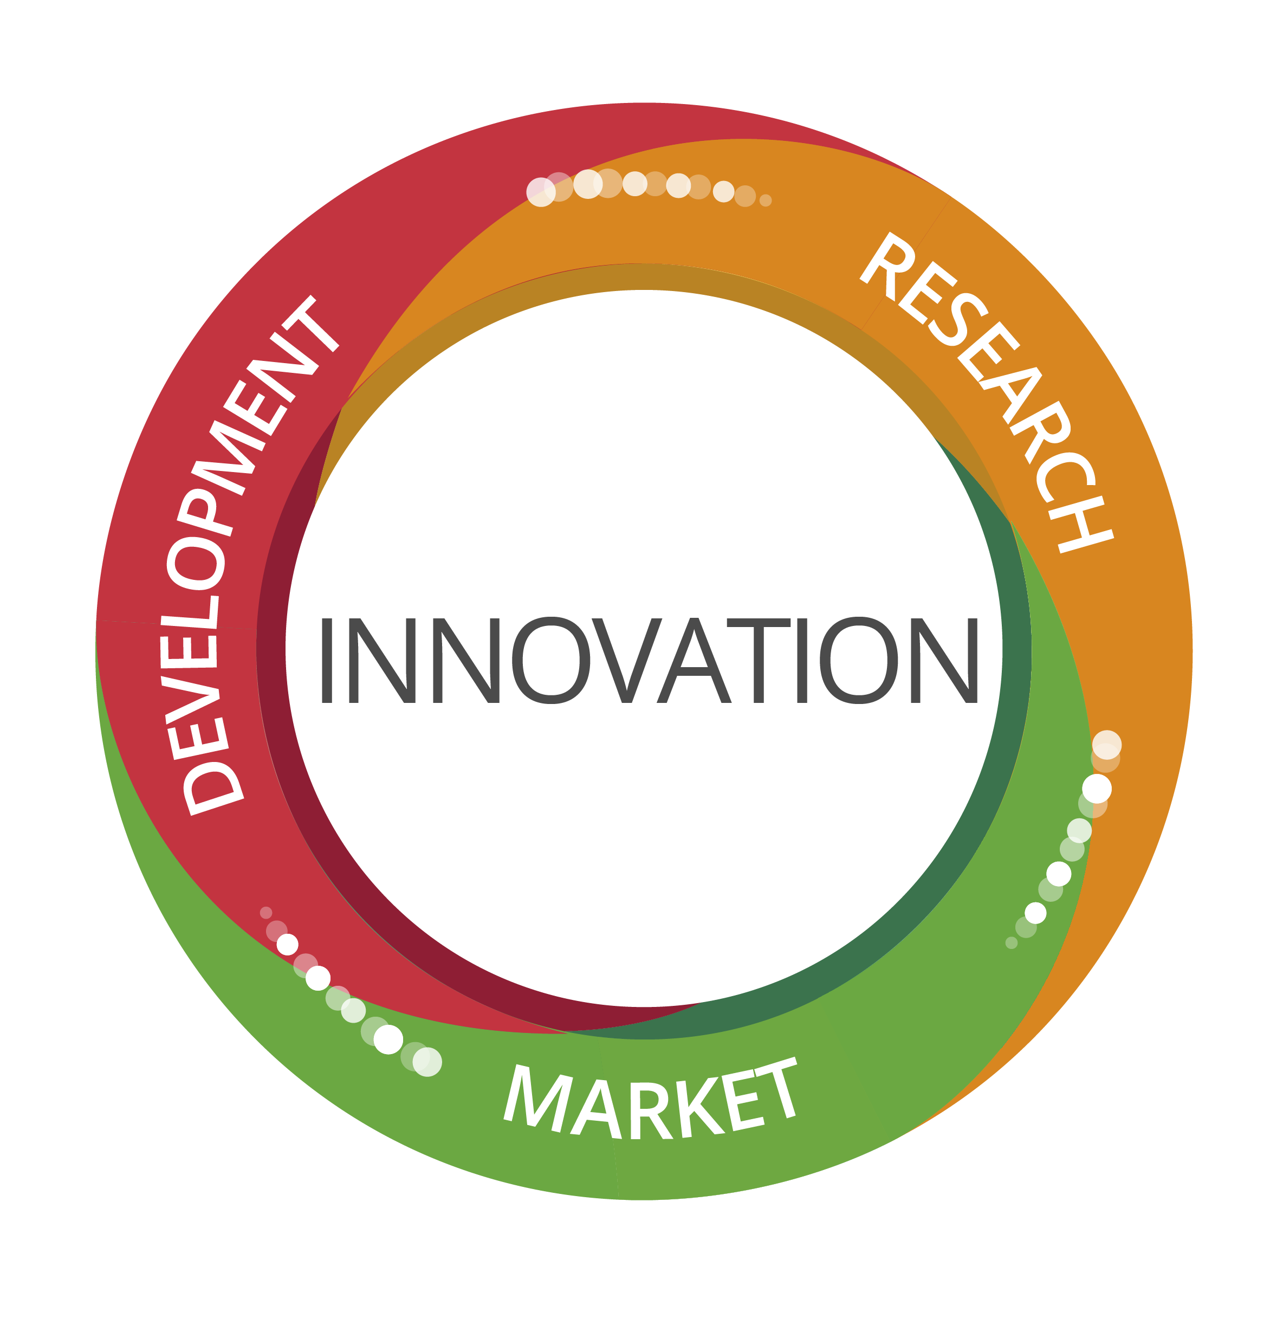

CPqD ROLE AND MODEL
Technology Transfer
R&D Program
Commercialization of Products and Services

Slide 4
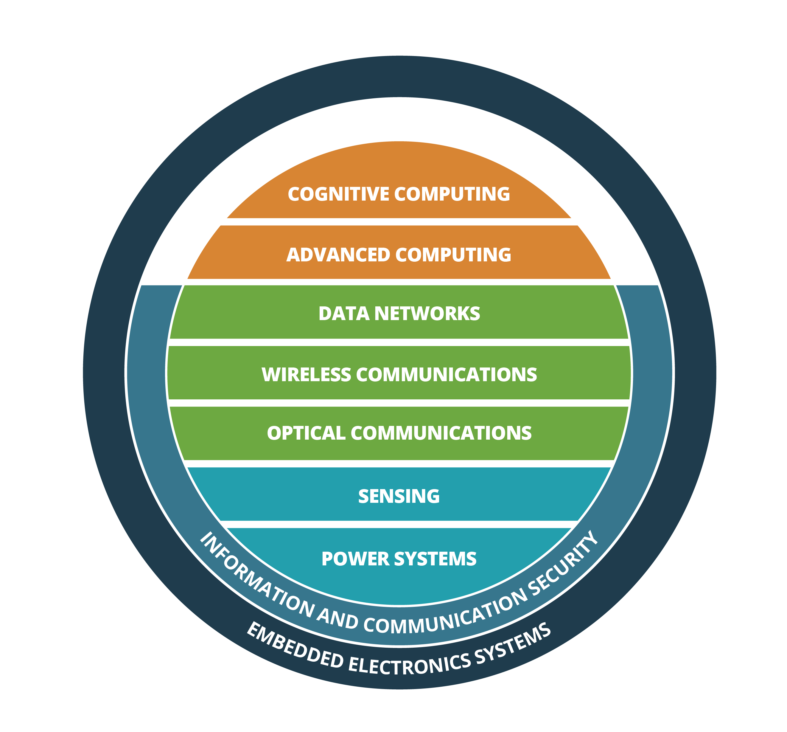
CPqD’s TECHNOLOGY PLATFORMS
Strategic areas for:
Knowledge
Intellectual Property
Infrastructure

Slide 5
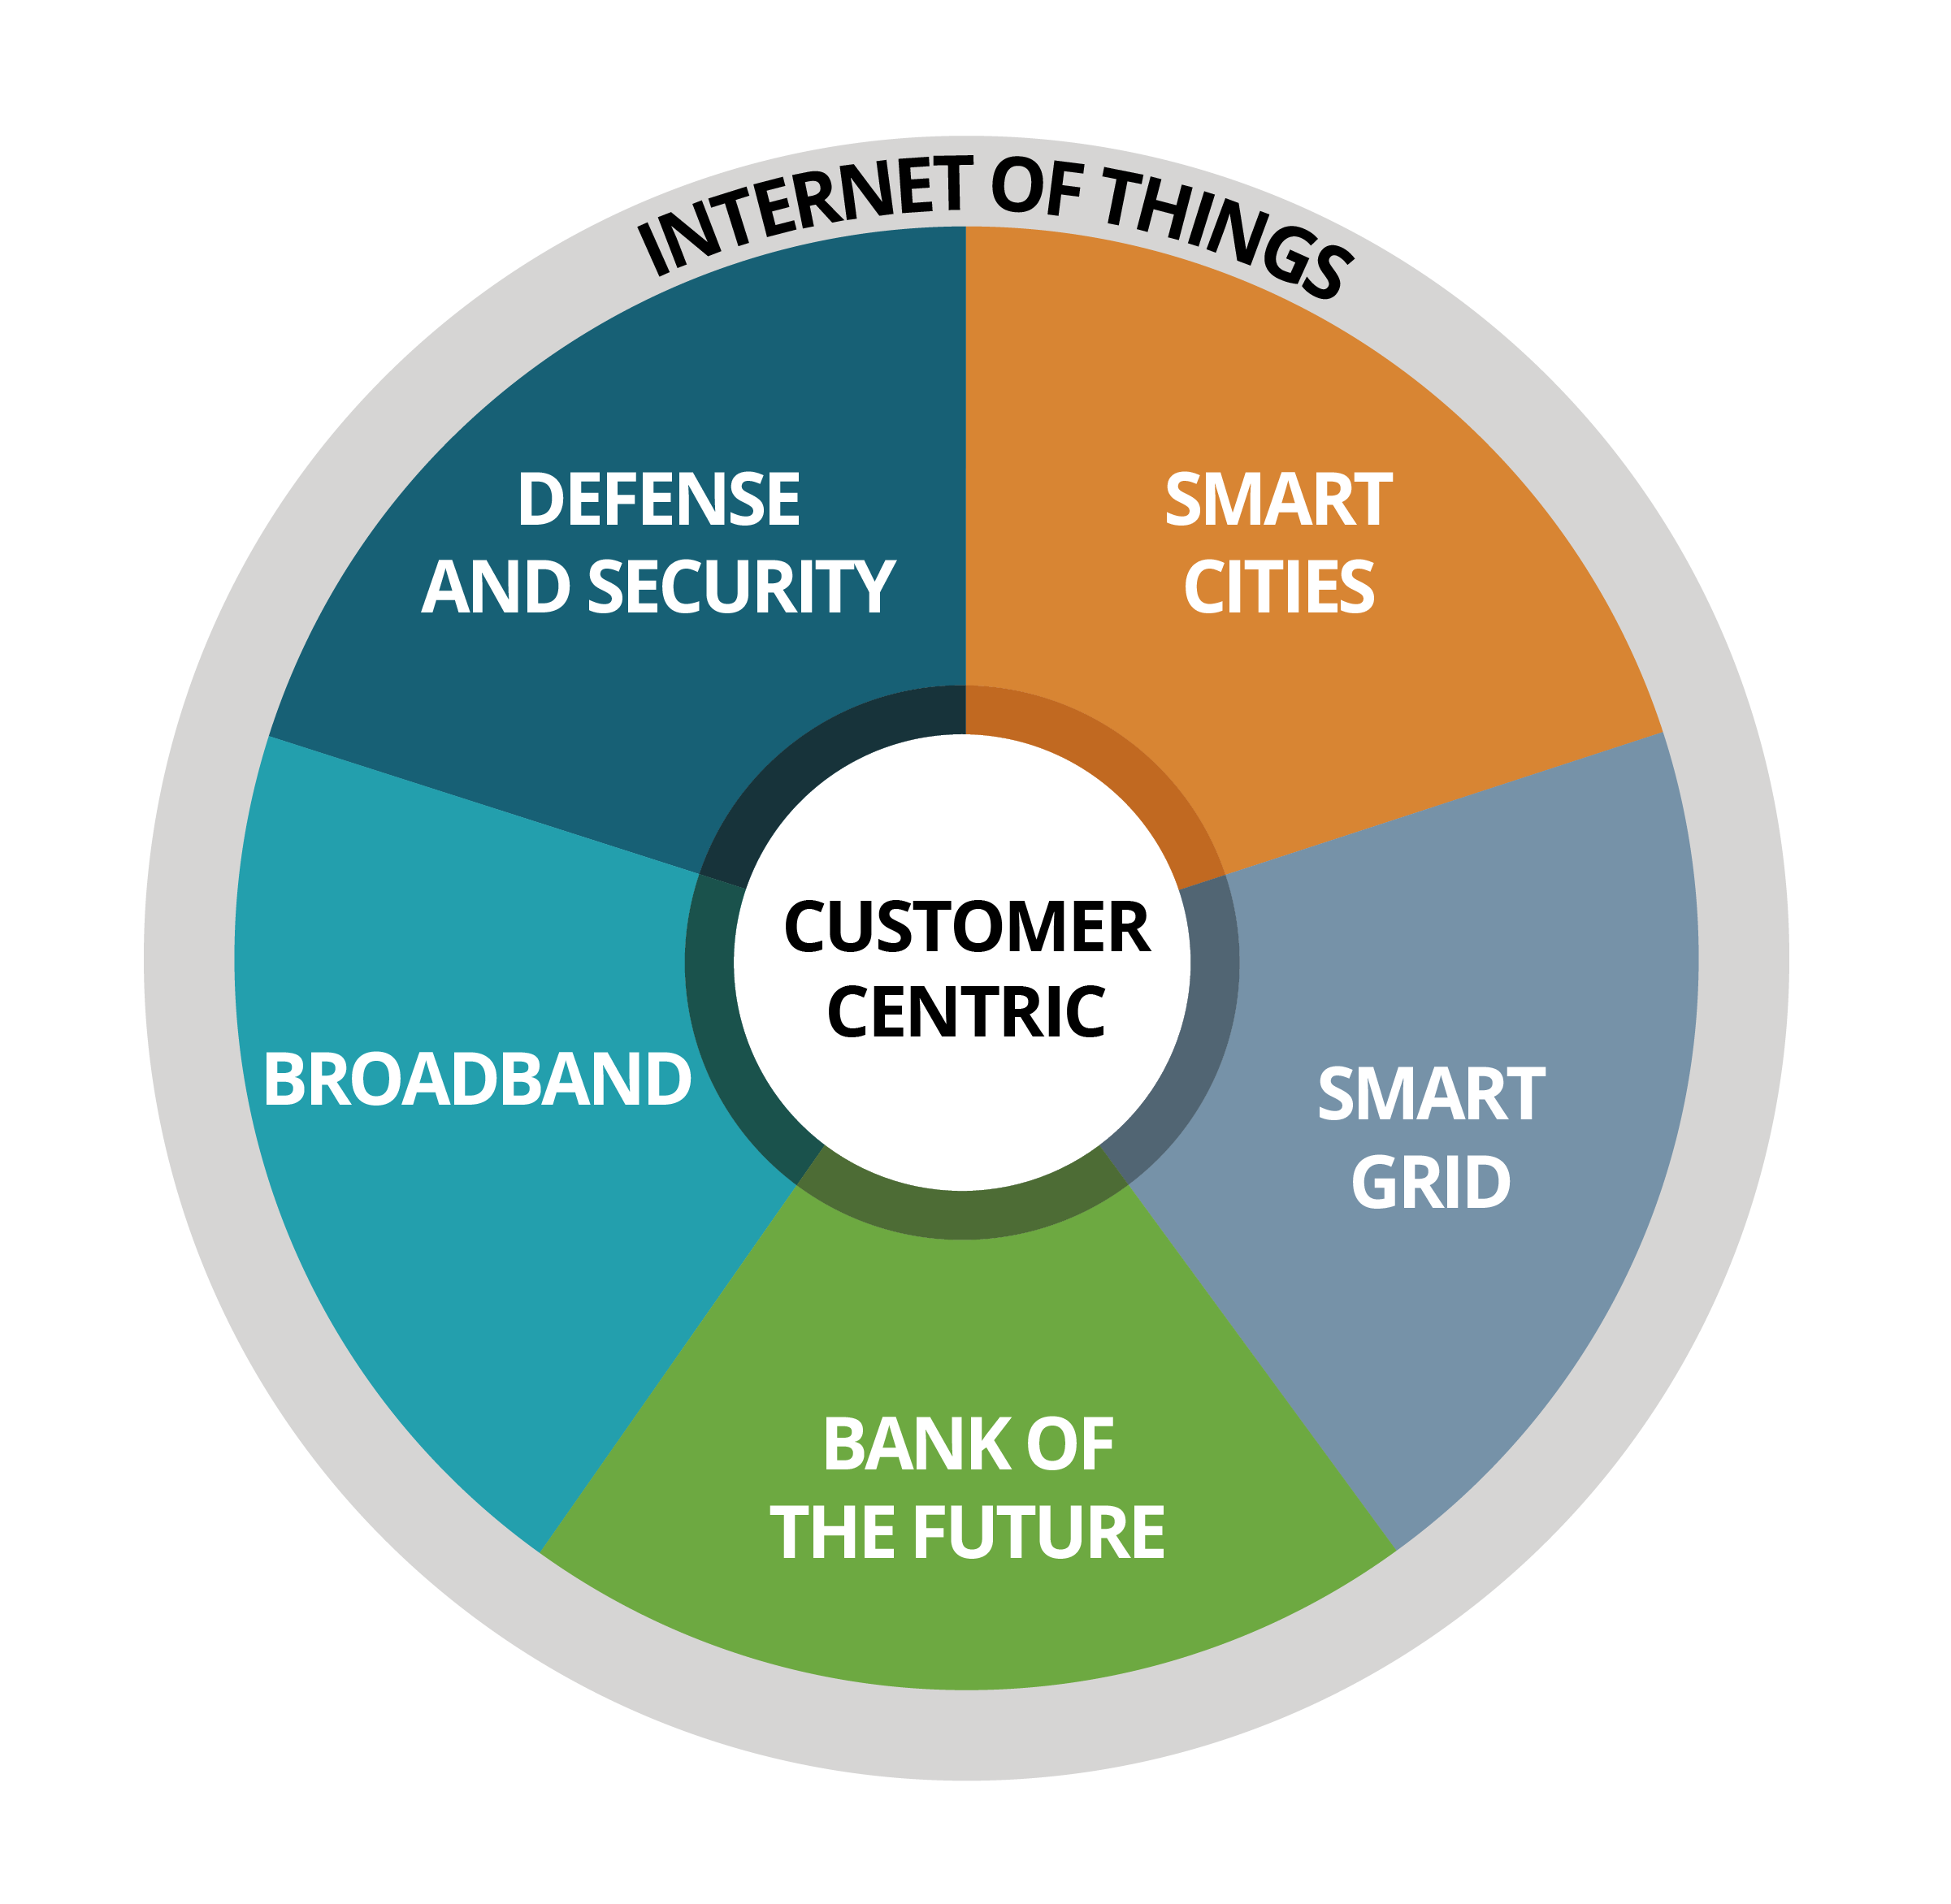
CPqD’s TECHNOLOGY PLATFORMS
Technology R&D
(products and process innovation)
Market
MAIN DRIVERS
CPqD FOCUS
CPqD TECHNOLOGY PLATFORMS

Slide 6
PROJECT: Precision Agriculture
Agriculture and Livestock Sector in Brazil
Lack of adequate data communication infrastructure prevents technological diffusion!
Case: Sugarcane and Ethanol Plant
R&D Project: Agrotics (2016/2017) funded by BNDES/FUNTEC
Development of a macro-cellular mobile communications system (LTE) and sensing in real time to optimize productivity in the field

Slide 7
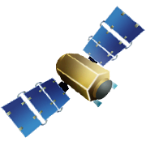
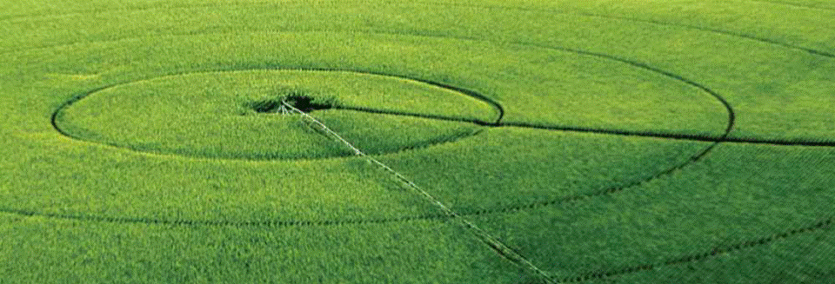



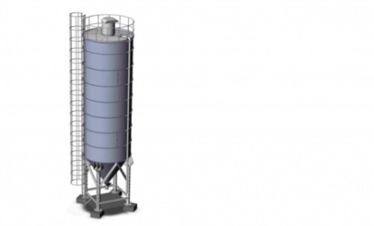

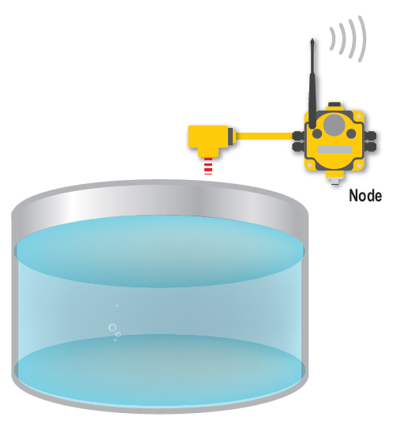

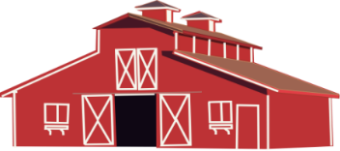
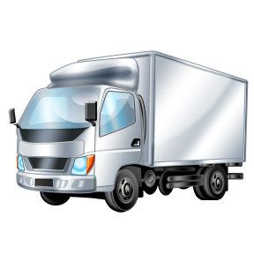
PROJECT: Precision Agriculture
Connectivity reach > 30km
Licensed frequency band (but no operator)
Low cost, robust equipment
GPS
Sensors and
actuators
Base Station
Access to applications and services
Internet

Slide 8
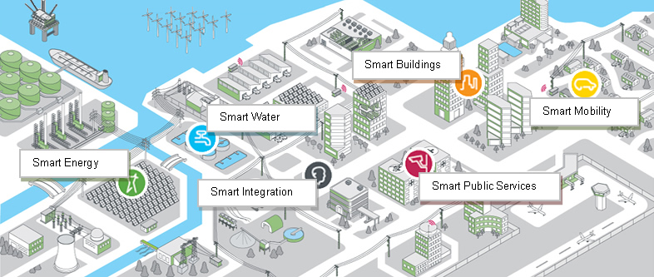
PROJECT: Smart Cities
Focus on:
Mobility
Health
Security
IoT Platform enabling Brazilian Smart Cities

Slide 9

PROJECT: Smart Cities
Smart Cities - Apps
Urban
Mobility
Public Safety
Public Health
Living Labs in selected Cities
Key:
Shared data
Shared resources
City Operating System
Traffic Lights
Cameras
Vital signs monitors
Car Counting
Resources

Slide 10

PROJECT: Smart Cities
Urban Mobility Case
  Telemetry for reducing fuel consumption and new risk profile for insurers;
  Wearables for monitoring drivers - level of stress and attention , vital signs;
  Dashboard for displaying indicators of fleet vehicles;
  Proof of Concept (PoC ) in some lines of public transport in selected cities;

Slide 11
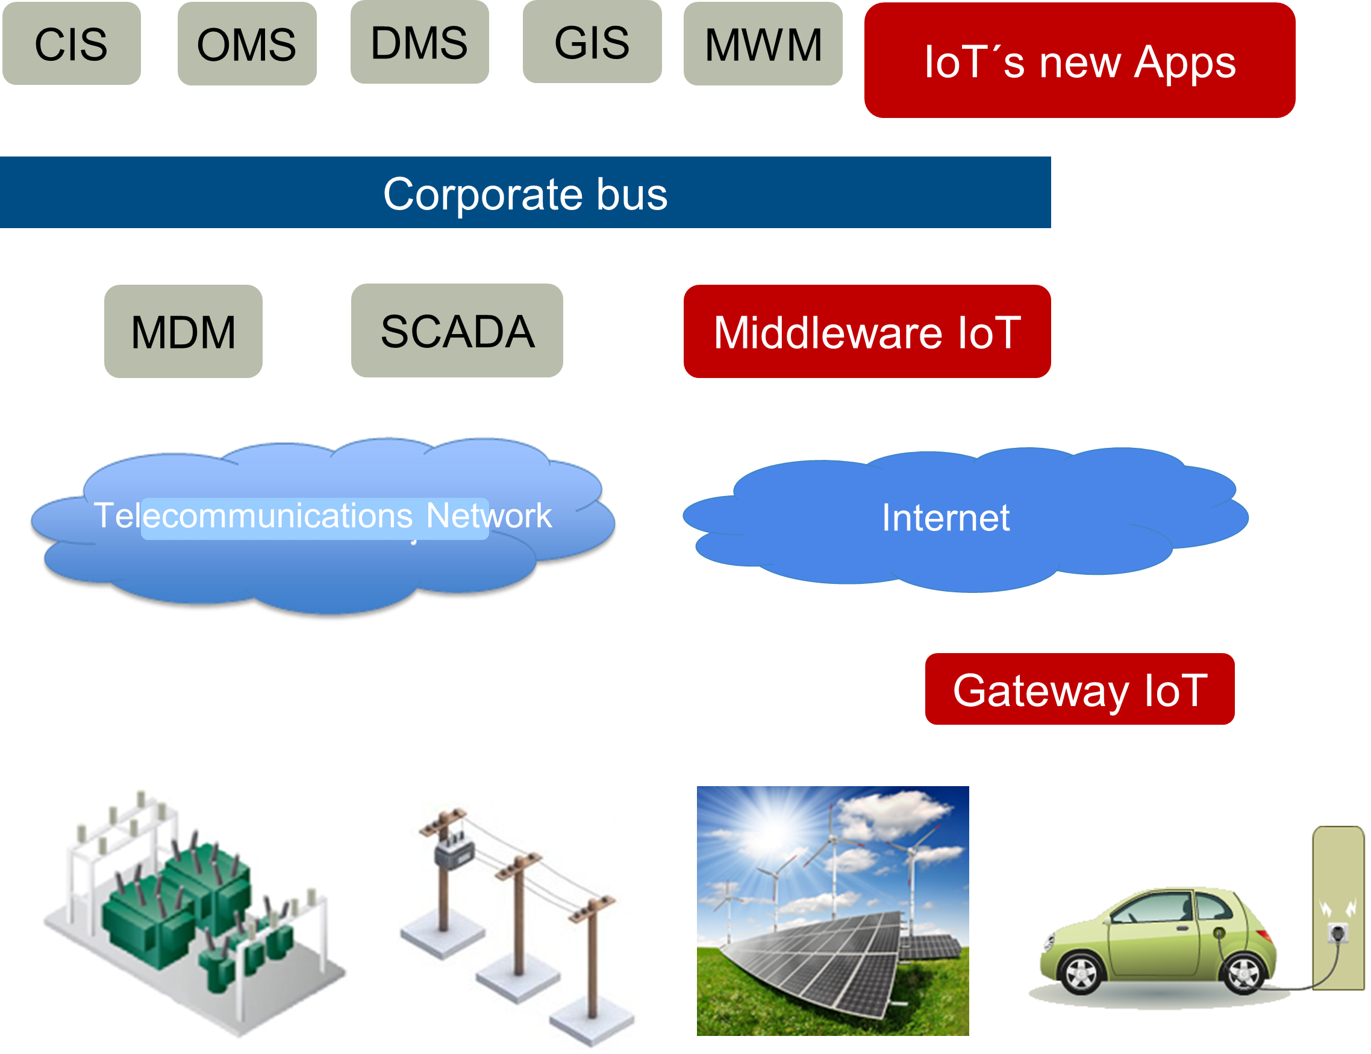
PROJECT: Energy and Smart Grid
  IoT comes as an architecture applicable to what already exists in Smart Grid, bringing solution to some noted challenges such as:
  Information security;
  Interoperability;
  Processing large amounts of data (Big Data);
  Integration among different systems;
  New consumer needs – renewable energy, electric vehicles.

