Slide 1
ALMANAC – Main tangible outcomes
IoT week 2016
2nd June 2016
Maria Teresa Delgado
Istituto Superiore Mario Boella (ISMB)

Slide 2
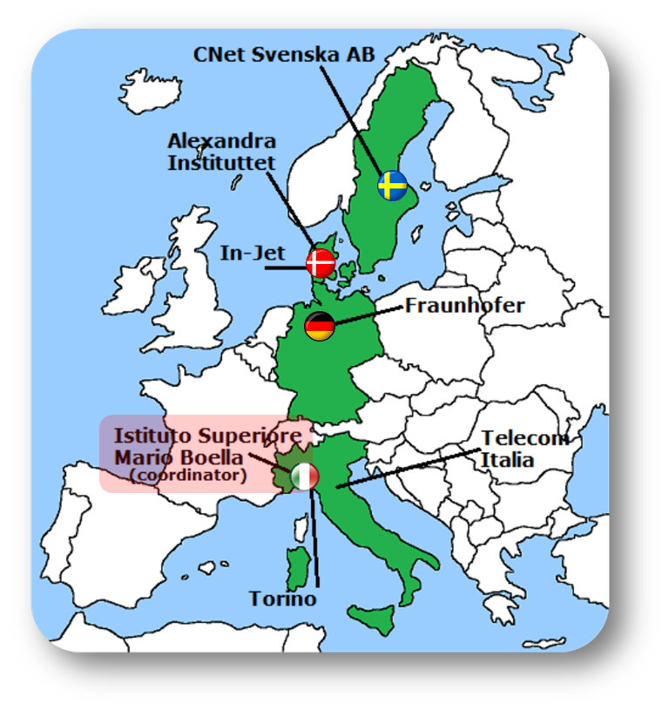







ALMANAC-FP7
IoT platform for Smart City applications
Three application areas:
Waste management
Water management
Citizen-centric
Development driven by requirements elicited from Turin’s City
ALMANAC results will be showcased and evaluated in Turin

Slide 3
Main Tangible Outcomes

Slide 4
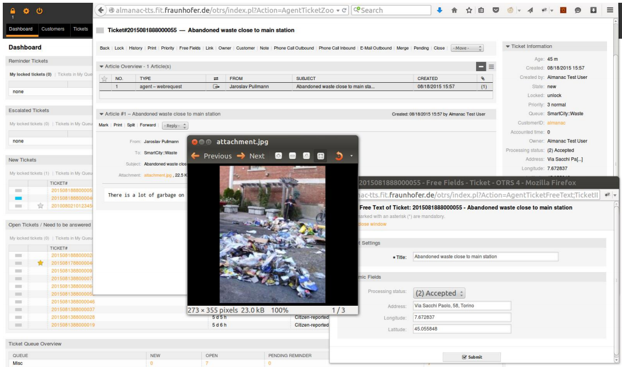
ALMANAC «Waste Applications»
Ticket Management System (OTRS integration)
Notes:
Open-source Ticket Request System

Slide 5
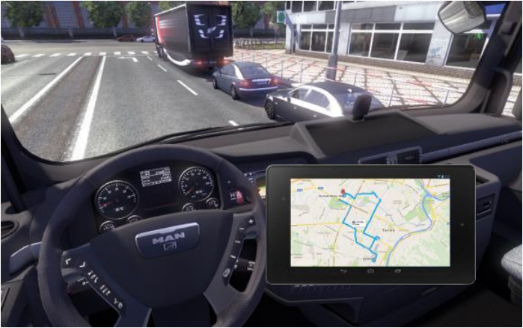
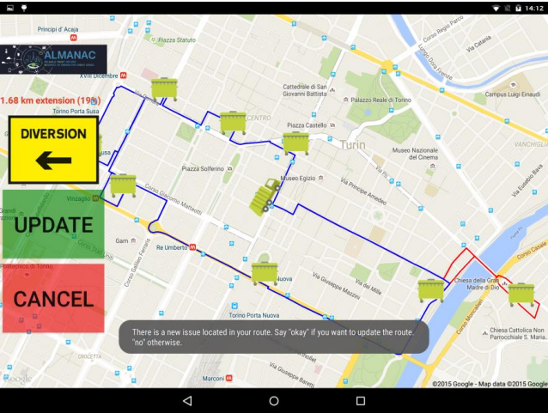
ALMANAC «Waste Applications»
Waste Collection – Route Optimization
Notes:
Open-source Ticket Request System

Slide 6
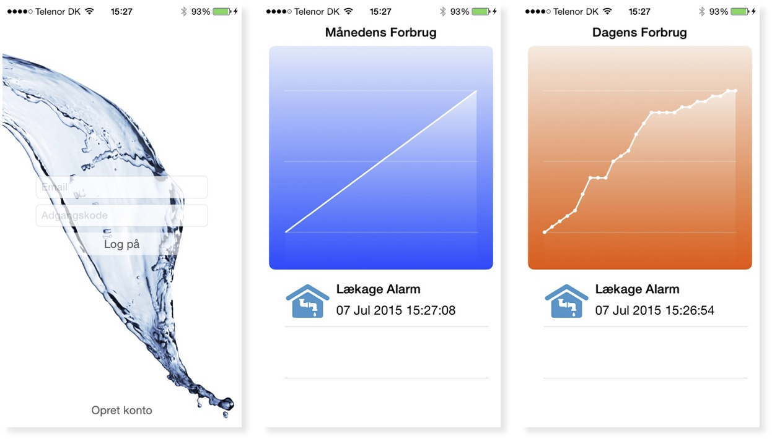
ALMANAC «Water Application»
Water Management – Leakage Detection
Notes:
Open-source Ticket Request System

Slide 7
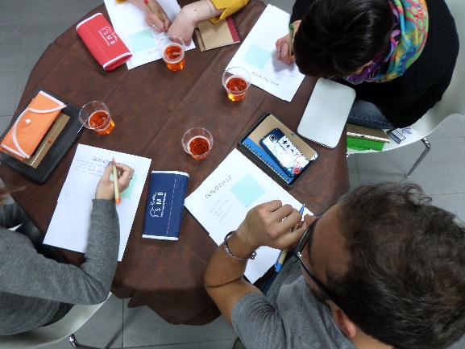
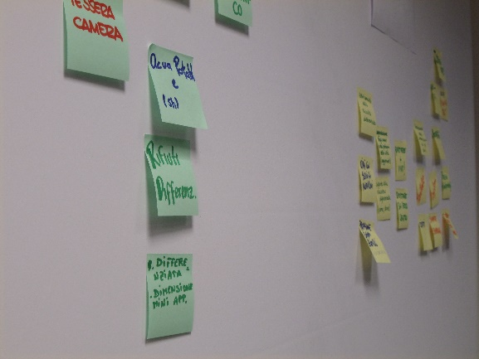
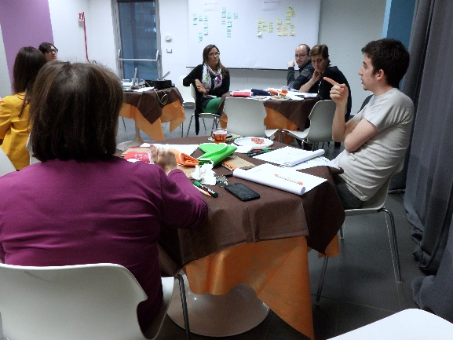
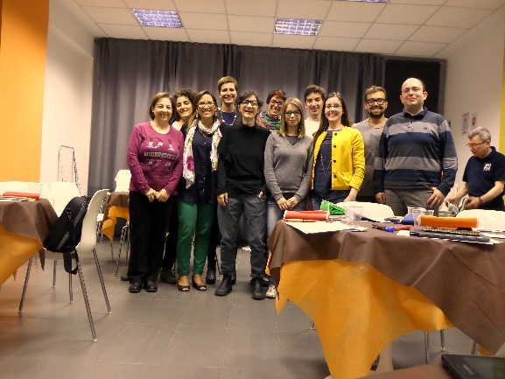
ALMANAC «Citizen-Centric Application»
Co-design approach implemented together with a community from Torino to identify citizen needs and desires

Slide 8
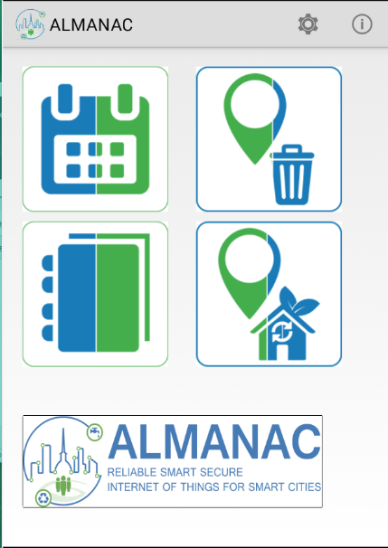
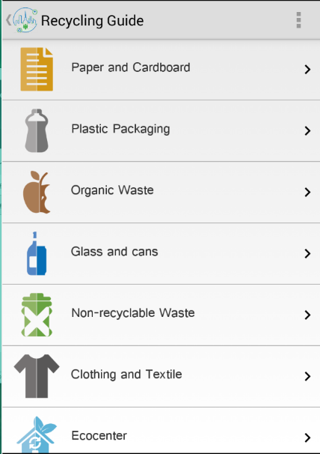
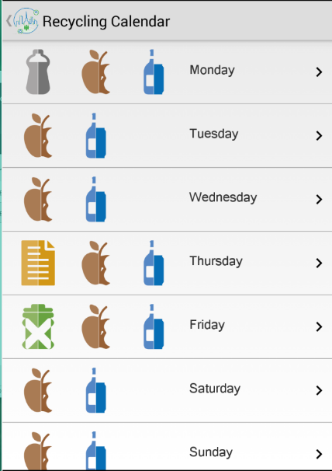
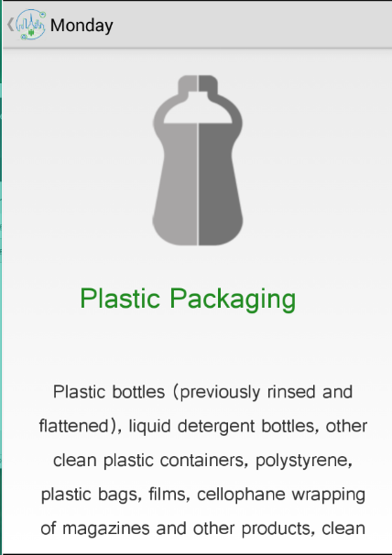
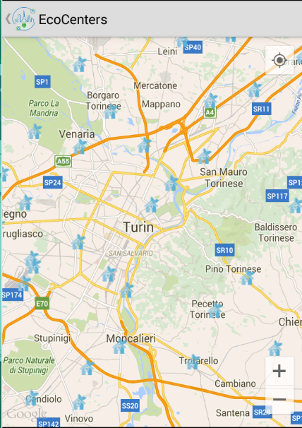
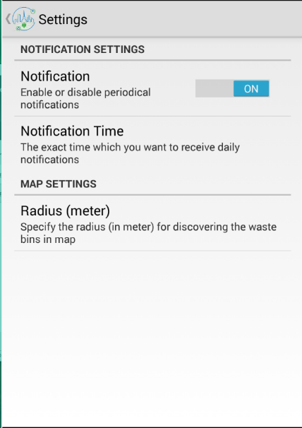
ALMANAC «Citizen-Centric Application»
Recycling Support Application developed with the citizens

Slide 9
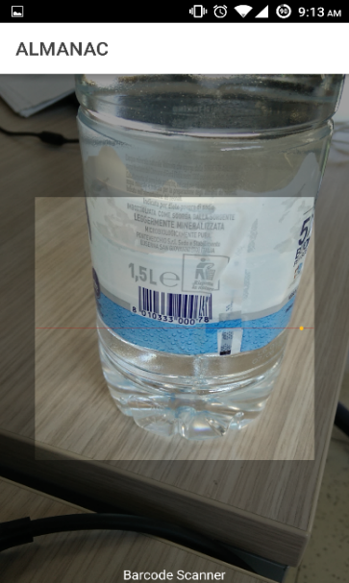
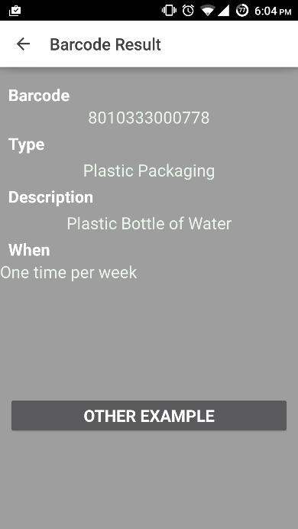
ALMANAC «Citizen-Centric Application»
Bar code scanner featuring crowd-sourcing for a collaborative recycling guide

Slide 10
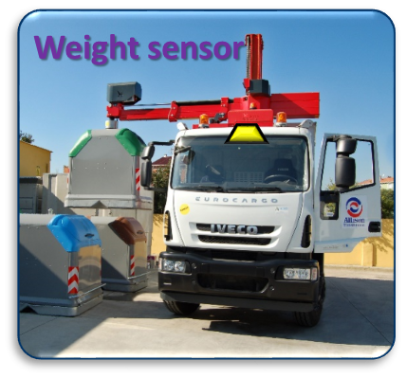
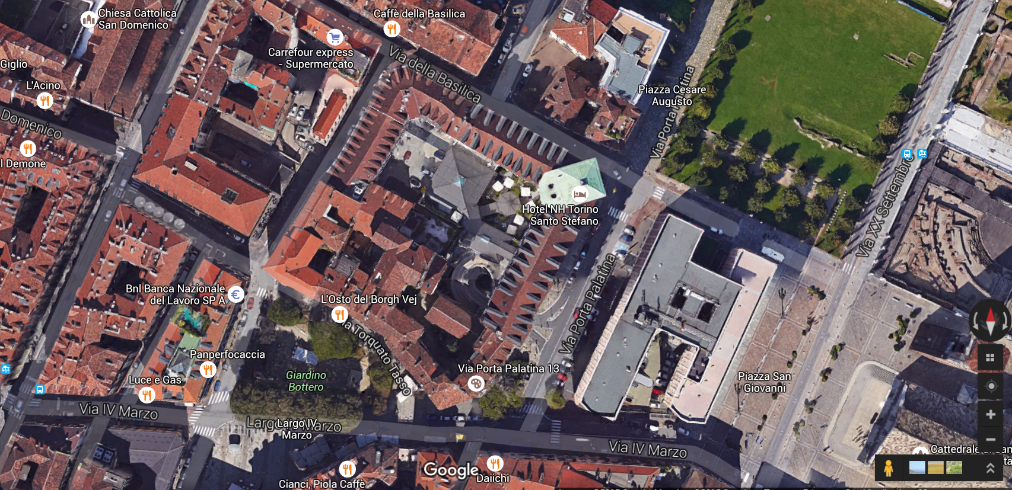
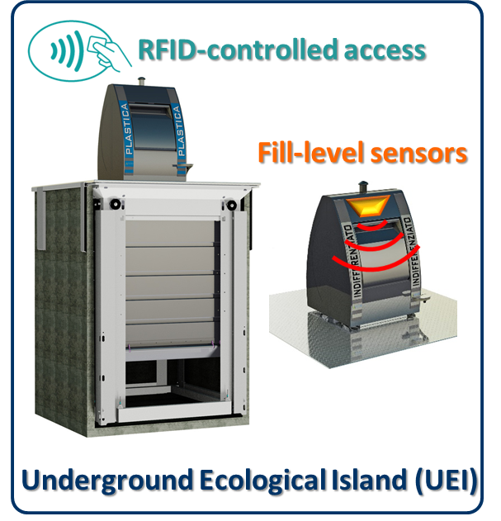

ALMANAC «WASTE Pilot Deployment»
Concerning 2 UEIs
Actors involved:
Citizens:
300 Families
90 commercial activities
AMIAT
NordEngineering, NGWay
Nord Engineering
EcoTec
NGWay
AMIAT
TRN

Slide 11
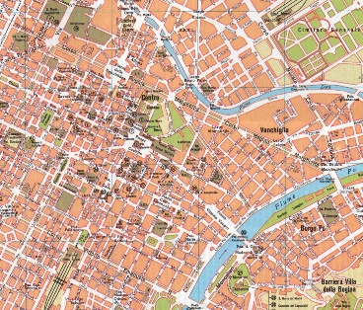
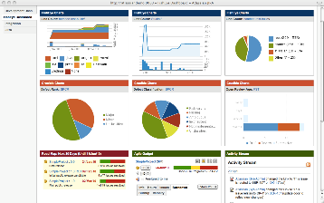










ALMANAC «WASTE Pilot Deployment»
Data visualization and services enabled by ALMANAC
One of the ALMANAC Platform instances, federated with other PIs
Open APIs
Collaborative Citizen-Centric Application
Waste trucks equipped with weight sensor and GPS
ALMANAC PI
UEI equipped with
fill-level sensors and access modules
(including solar panels)

Slide 12
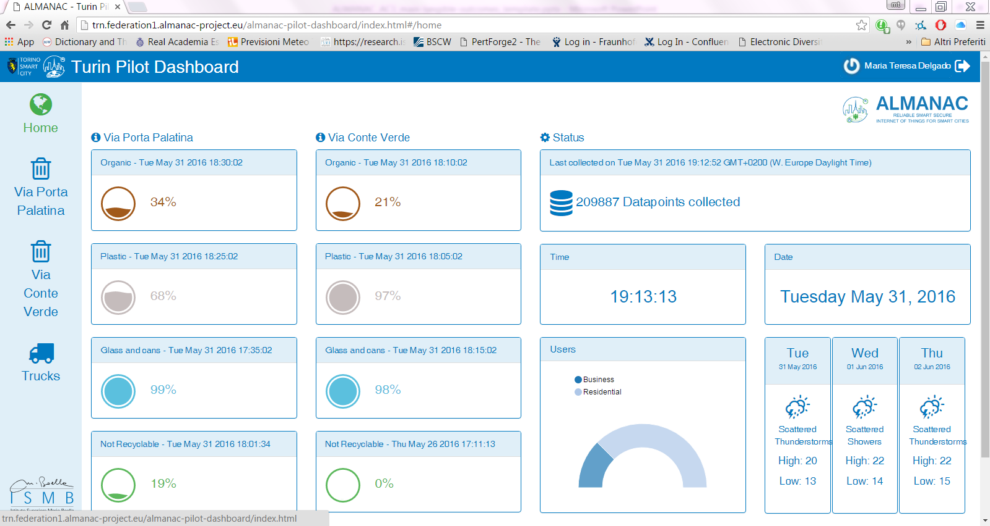
«WASTE Pilot Deployment DASHBOARD»
Developed to enable a user-friendly visualization of the real-time ﬁll level representation.
Enables Waste utility service operators to quickly react to anomalous situations and verify the UEI situation on real-time

Slide 13

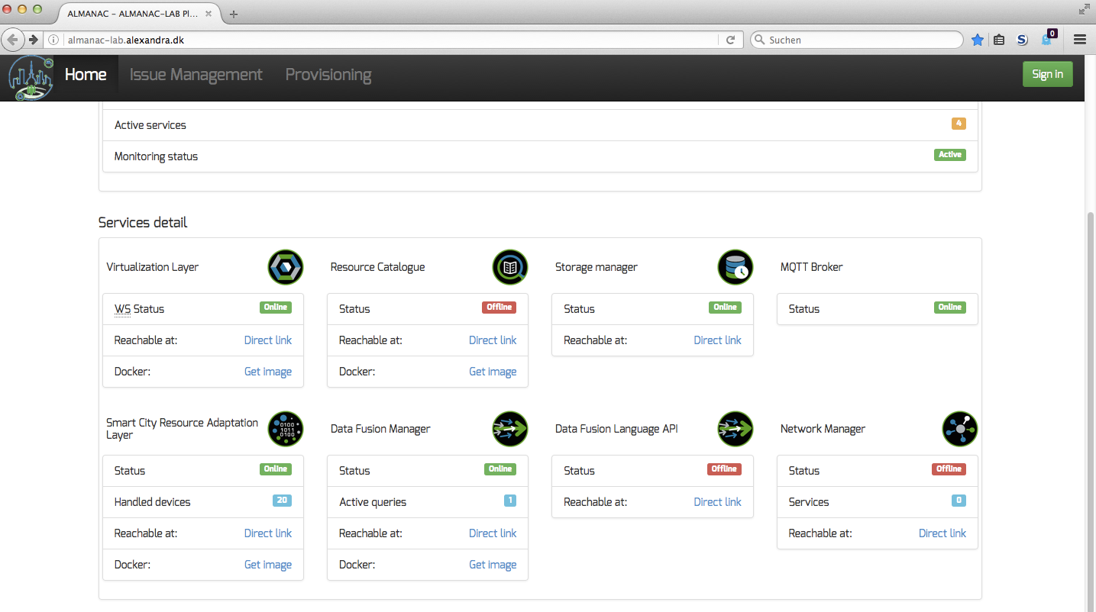
ALMANAC LAB
Public Testbed for ALMANAC components
Try our free dockerized Smart City enablers out:
http://almanac-lab.alexandra.dk
https://hub.docker.com/

Slide 14
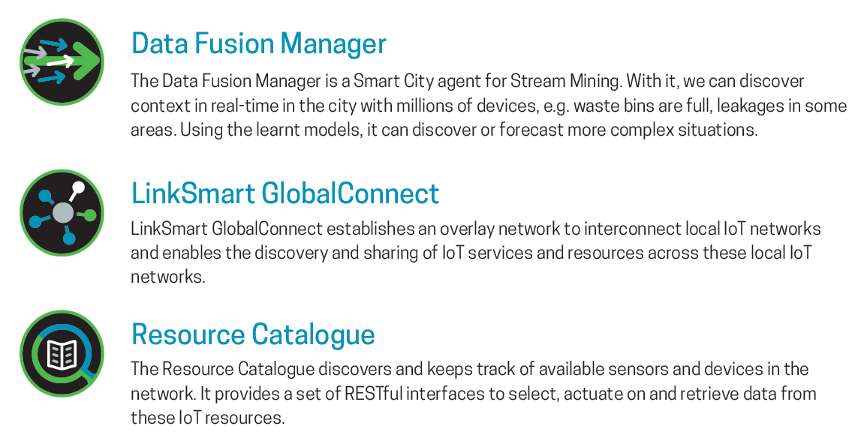
ALMANAC LAB

Slide 15
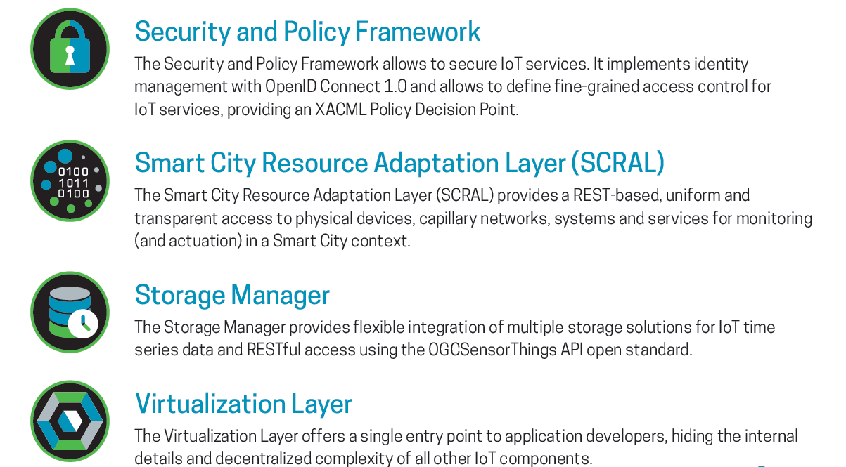
ALMANAC LAB

Slide 16

Thanks for your attention
All rights reserved. All copyright for this presentation are owned in full by the ALMANAC Project. Permission is granted to print material published in this presentation for personal use only. Its use for any other purpose, and in particular its commercial use or distribution, is strictly forbidden in the absence of prior written approval.
The project is co-funded by the European Commission under grant agreement 609081.
This presentation reflects solely the views of its authors. The European Commission is not liable for any use that may be made of the information contained therein.
Please see us here: www.almanac-project.eu
16

Slide 17
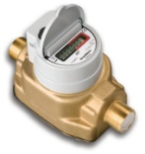









ALMANAC «Open-Source Components»
Smart City Applications
Cloud-based APIs
Under License Apache 2.0
Adaptation Layer
Virtualization Layer
Data Fusion Manager
Resource Catalogue
Storage Manager
Metadata Framework
Open Cloud-based APIs
Smart City Middleware
Multiservice
Federated
Networks
Ontologies and Semantic
Representation Framework
Data Management Framework
Communication Management Framework
Security and Privacy Framework
Event Filtering and
Context Management
Event Management and Reasoning
Information Aggregation, Storage and Mining
External Cloud Infrastructure (IaaS)
WAN
Abstraction Framework
Virtualization Layer
MAN
Adaptation Layer
LAN
Smart City Resources
Personal Devices
Utility Resources
(Devices, Systems and Services)
External Services
Capillary Network
Other Utilities/
Operators
Citizens
Public Administration
Water Supply Network
Waste
Collection
Network
Open data

