Slide 1
Smart System integration for Smart Water monitoring
Franck LE GALL, Easy Global Market
02/06/2016
Belgrade

Slide 2
Project overview: context
Water scarcity in EU impacts11% of population; 17% of territory
Stakes associated to drinking water:
  Detection of health-threatening pollution levels (continuous, accidental or intentional)
  Detection/mitigation of losses
Stakes associated to waste water:
  Management of variable levels
  Minimized impact on ground water

Slide 3
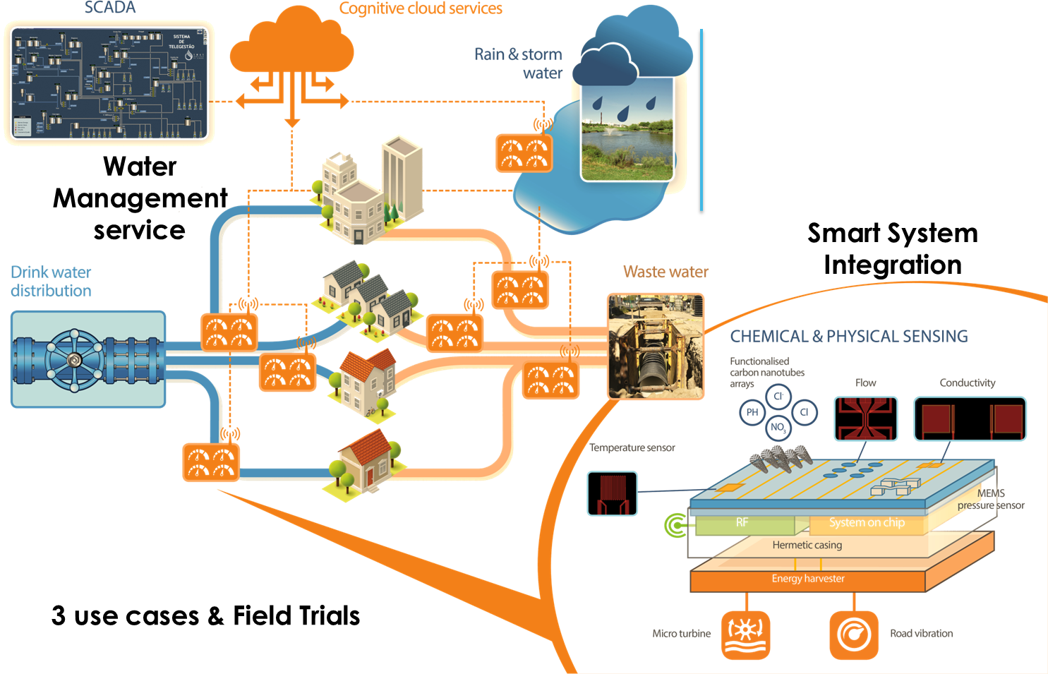
Project overview: our solution

Slide 4
Scope and Objectives
Objective #
Objective #2
Objective #3
To provide a monolithic multifunctional sensing chip
To provide a smarter system
To ensure manufacturability, reliability and cost-effectiveness for water monitoring applications

Slide 5
Impact
Added functionalities:
  9 parameters instead of 7 in drinkable water SOTA
  Applicable to rain/waste water Energy autonomy
  Reaction, prediction, and cognition functions
Size: 10x decrease in volume
Lifetime: 8x increase (from 3 months to 2 years)
Cost: 2.5x reduction in pre-series (within Proteus); 30x at industrial level

Slide 6
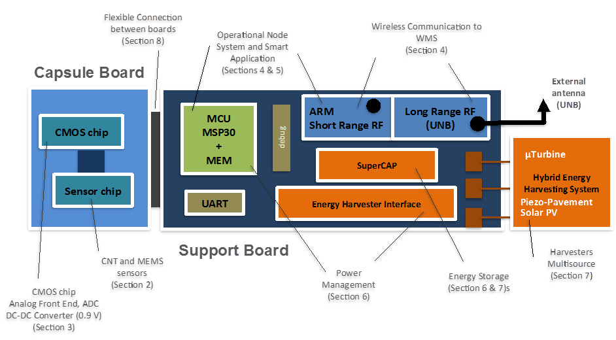
Main achievements (Year 1)
Completed analysis of use cases (D1.1)
Business & manufacturability (D1.3)
Requirements elicitation (D1.2)
Co-design of 1st run (D2.1)

Slide 7
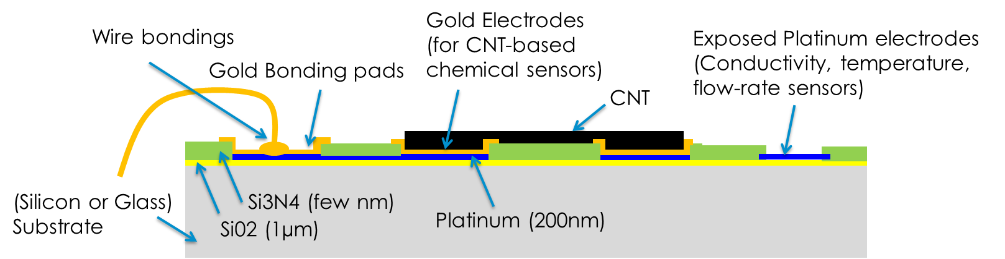
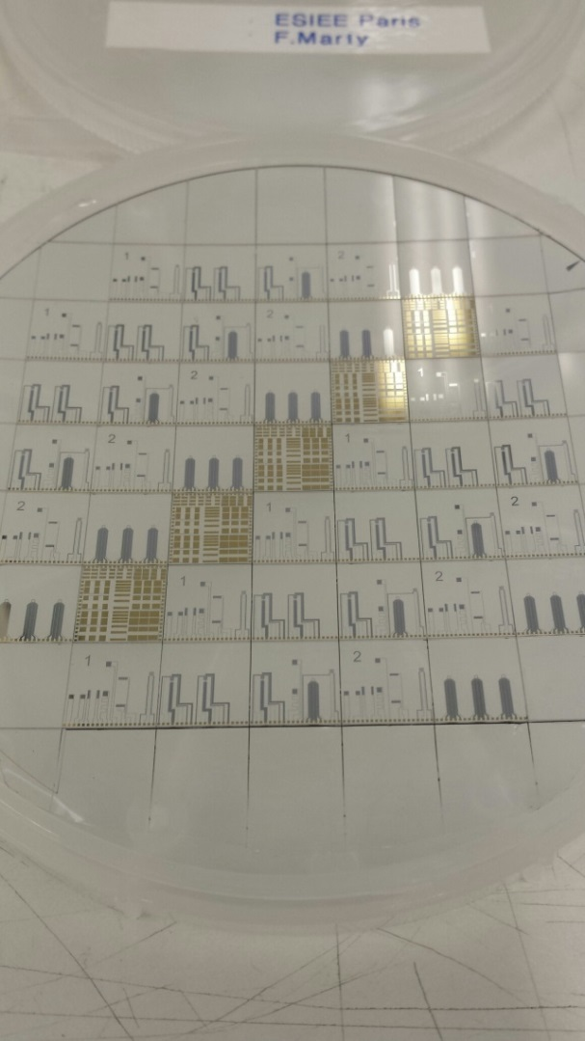
Main achievements (Year 1)
Fabrication and validation of all components of the sensor chip (in progress)

Slide 8
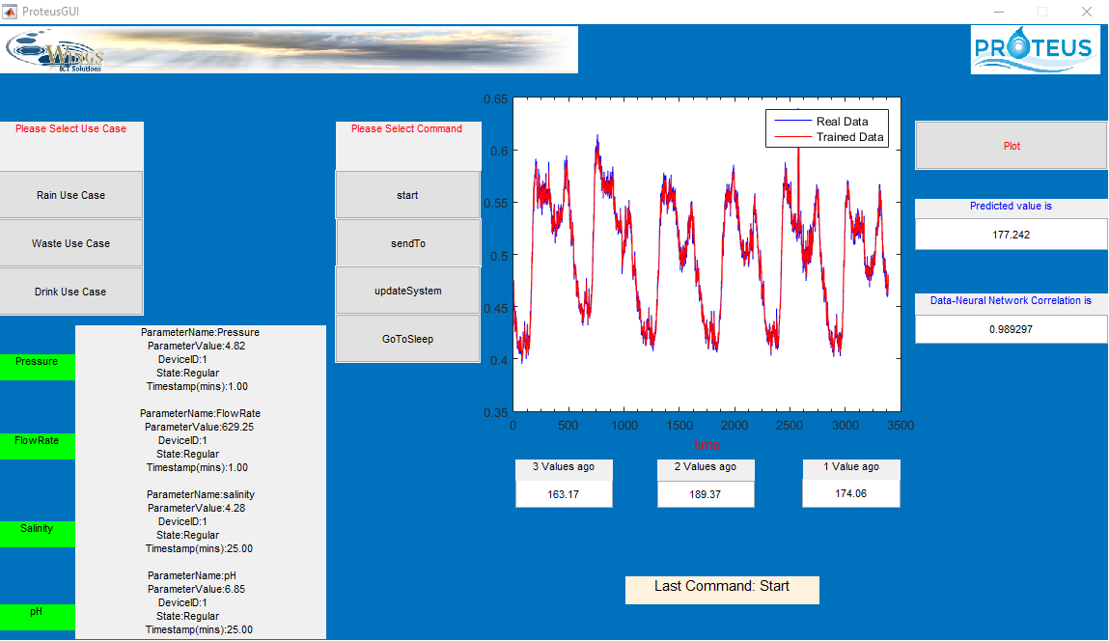
Main achievements (Year 1)
First version of the operational (reactive) and predictive software, development of communication strategy

Slide 9
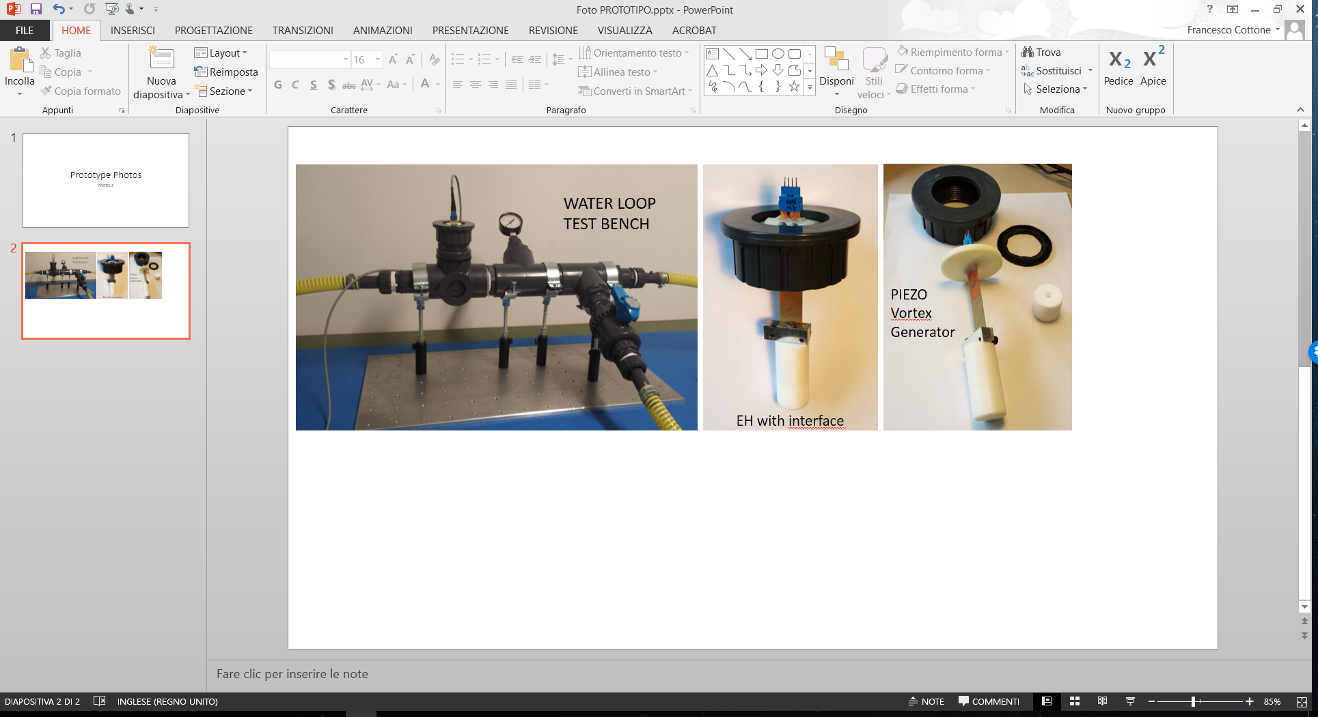
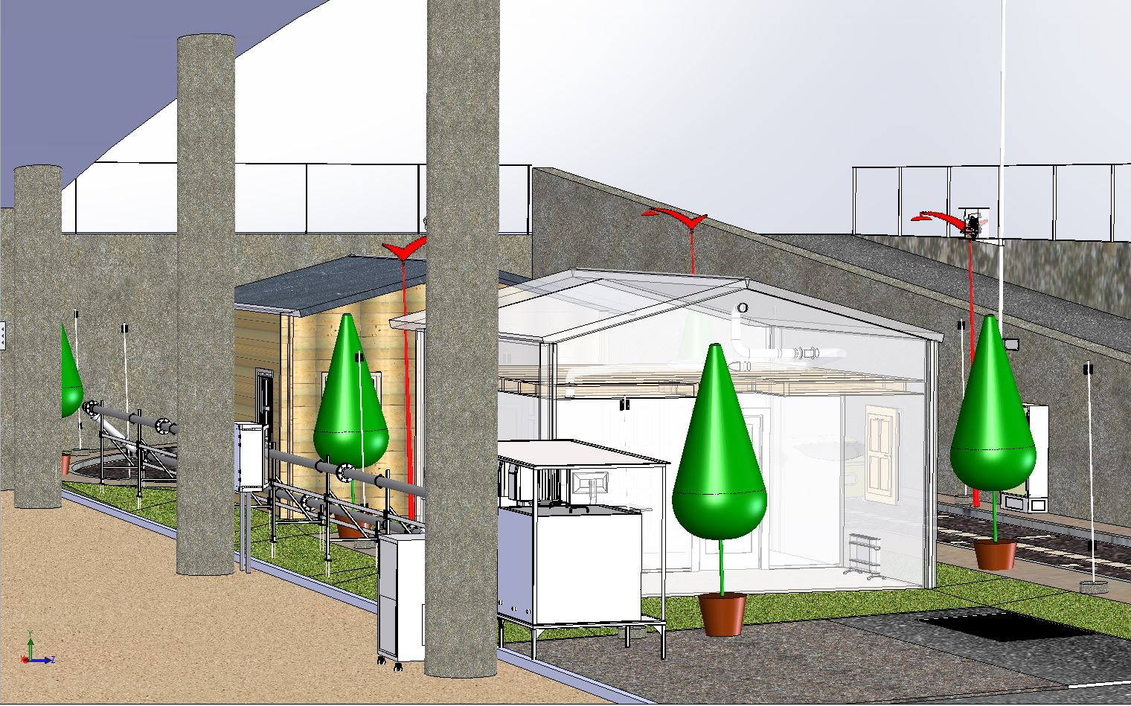
Main achievements (Year 1)
Design of energy harvesting solution; preparation of system assembly, lab and field trials.
Drinking Water Loop

Slide 10

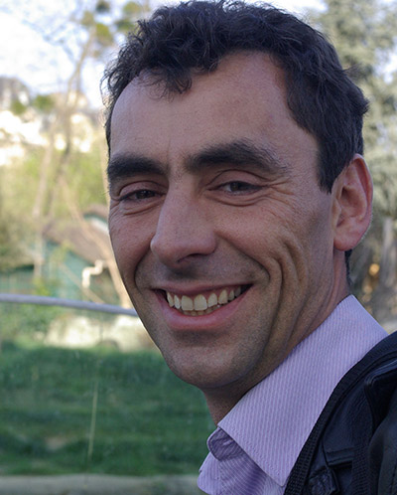
Thank you!

