Slide 1


Oliot: Data Driven Internet of Things Standard Platform & Ecosystem Oliot / Smart Agriculture / Smart Healthcare / Smart City
Daeyoung Kim
Professor, School of Computing, KAIST
Director of Auto-ID Labs, KAIST
Korea Advanced Institute of Science and Technology
kimd@kaist.ac.kr, http://oliot.org, http://autoidlab.kaist.ac.kr, http://resl.kaist.ac.kr http://autoidlabs.org http://gs1.org

Slide 2
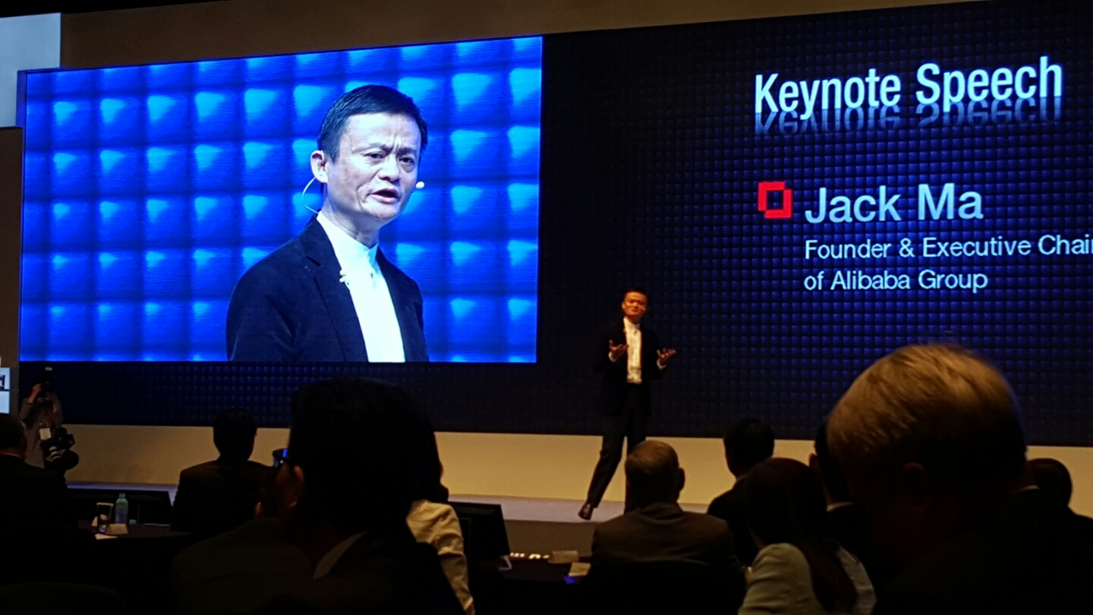
Data Technology Era is coming
Jack Ma(馬雲·51), CEO, Alibaba, Asian Leadership Conference 2015 Keynote
“Move from IT to DT era”

Slide 3




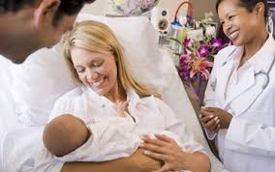
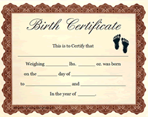
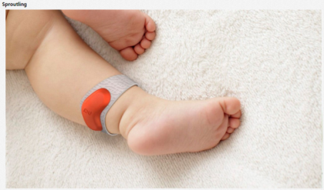
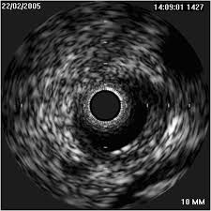
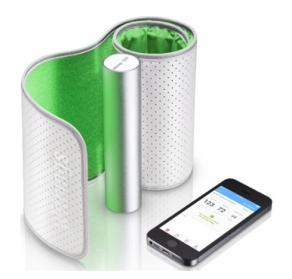
Collection of Lifetime Data of all People on Earth “makes a business happen so far”
Business, Healthcare, Industry, Education …

Slide 4
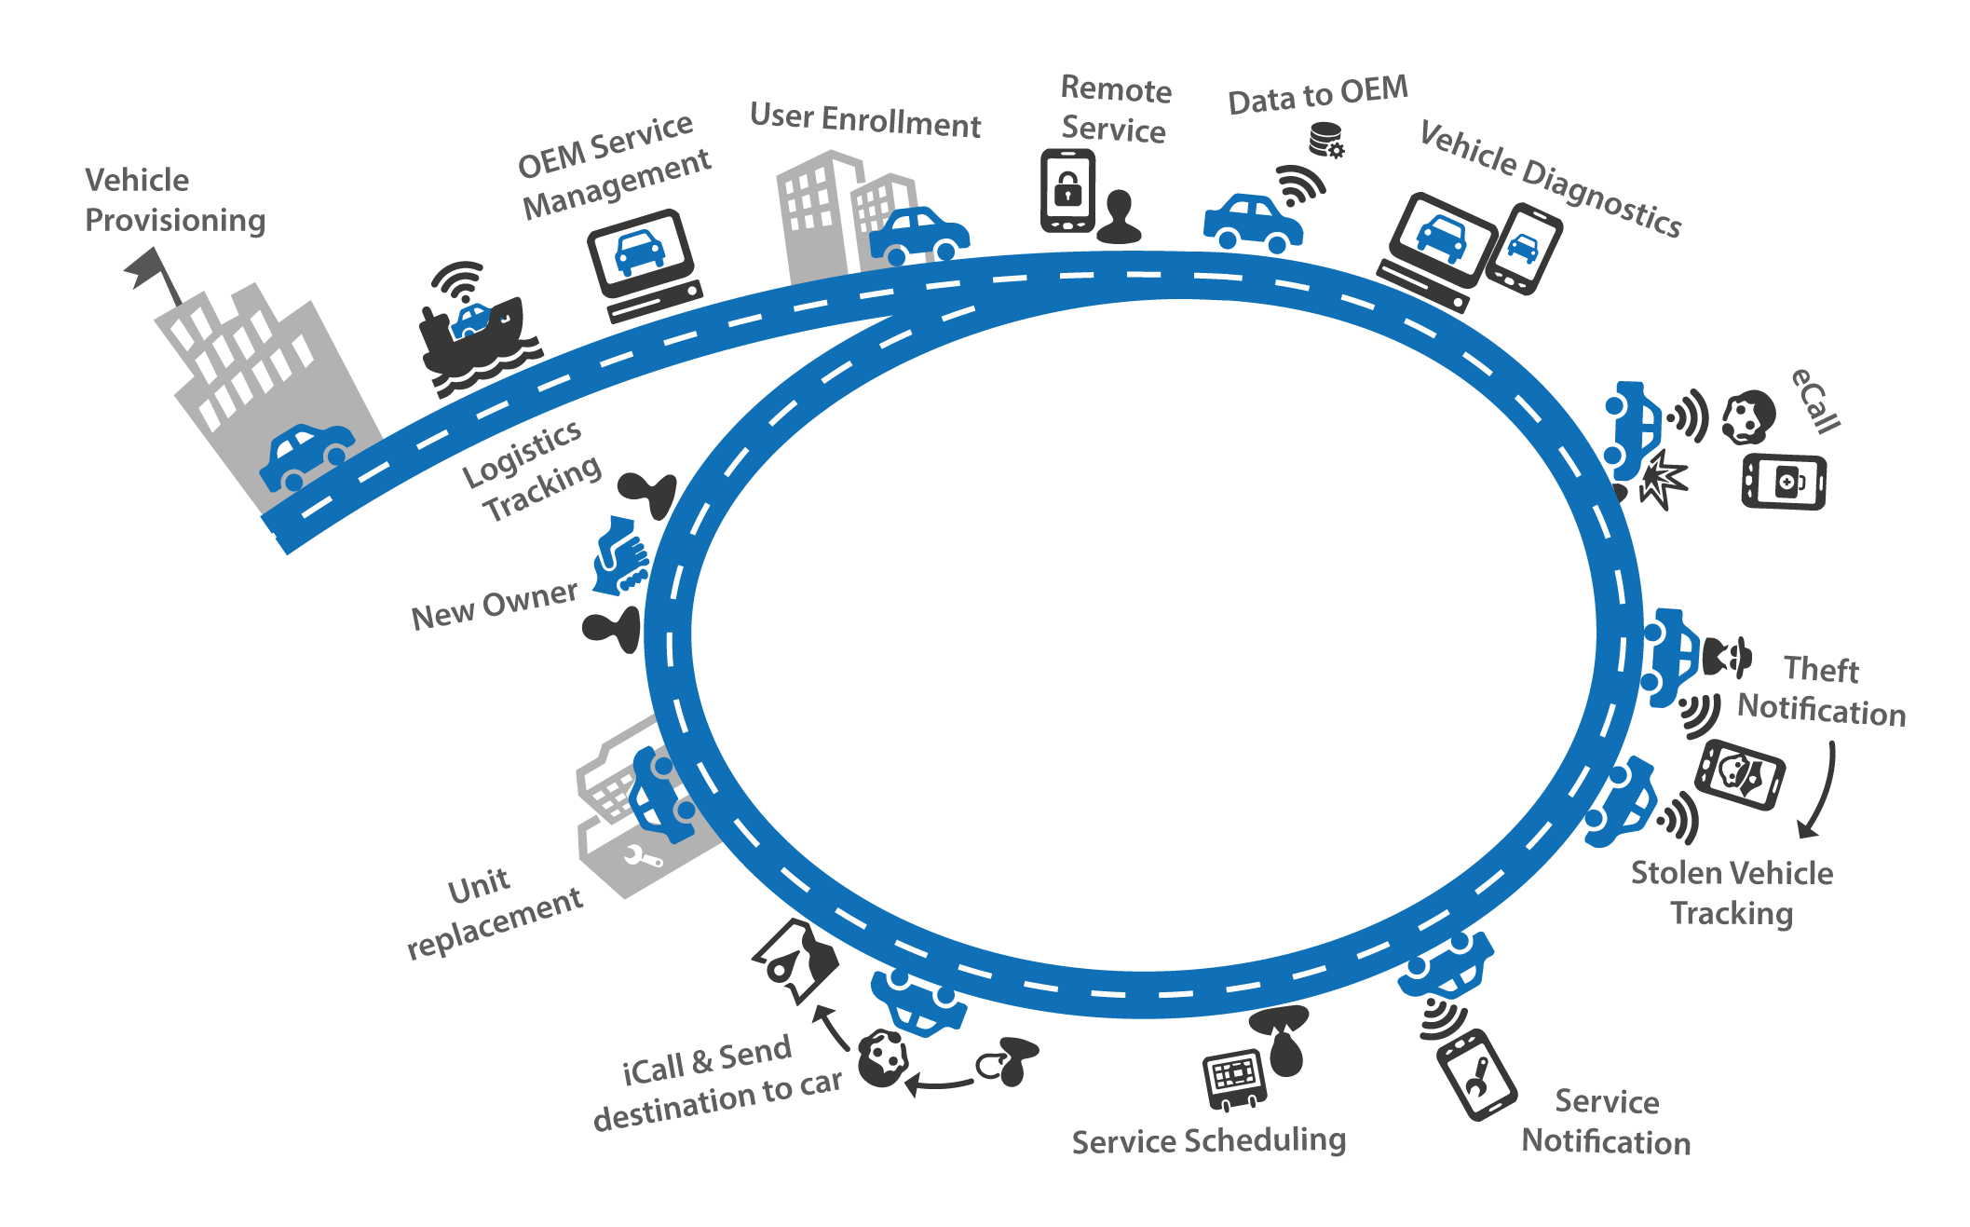
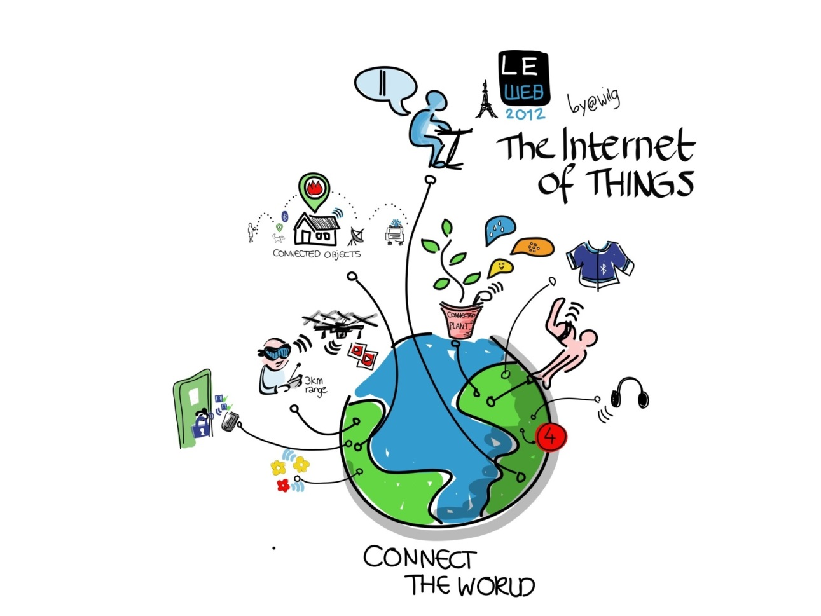
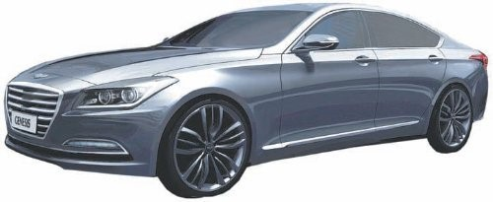
Lifetime Data of Things is also essential in IoT & DT Era Connected Cars

Slide 5
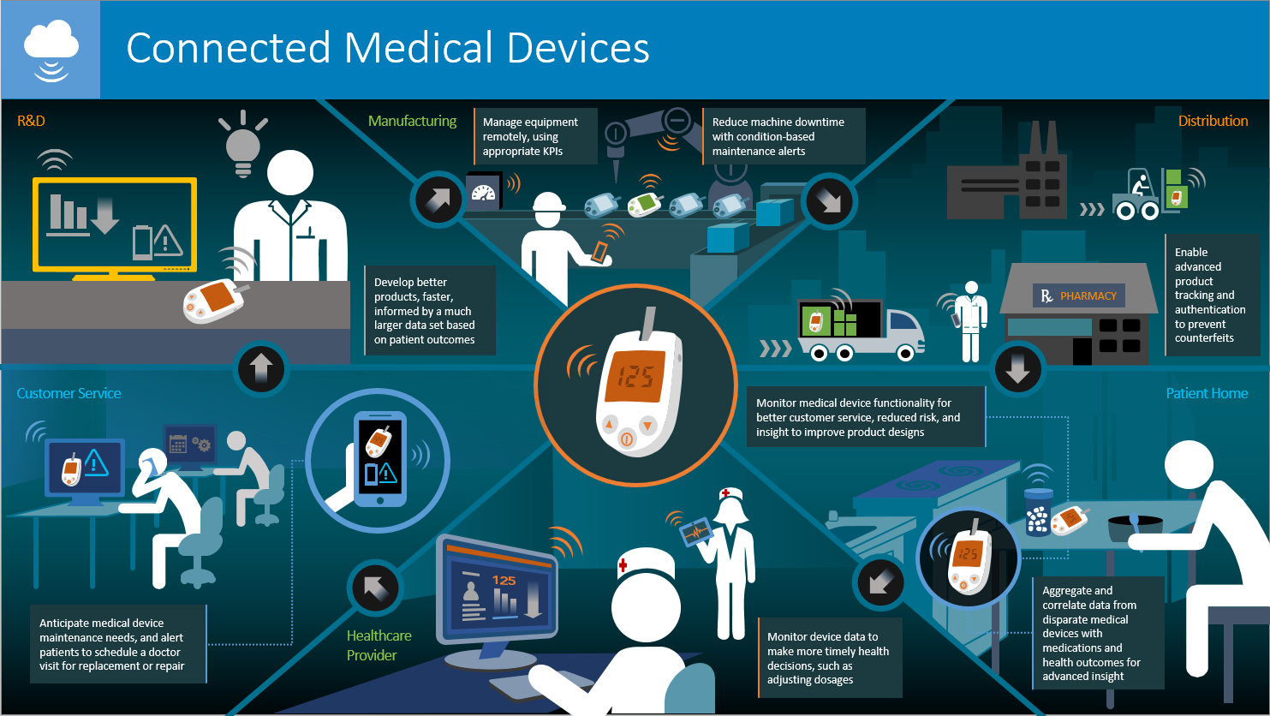
Lifetime Data Sharing, Healthcare too

Slide 6

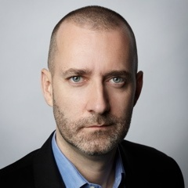


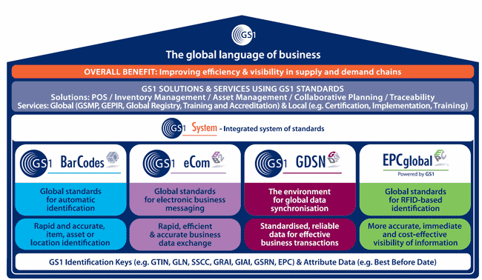
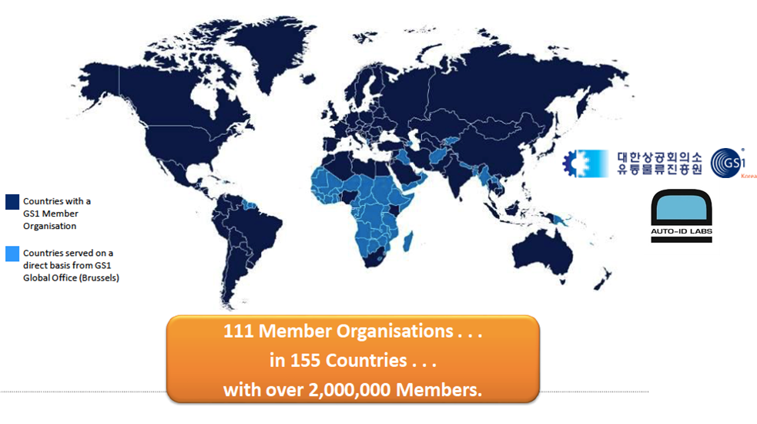
GS1 (The Global Language of Business)
In 1999, the Internet of Things" was first coined by Kevin Ashton who cofounded the Auto-ID Center(Labs) at the MIT
http://gs1.org

Slide 7
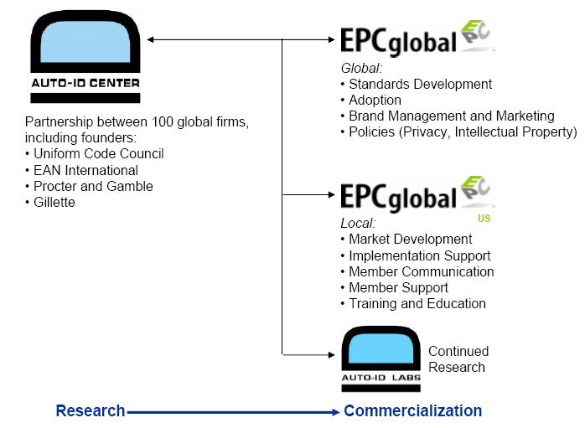
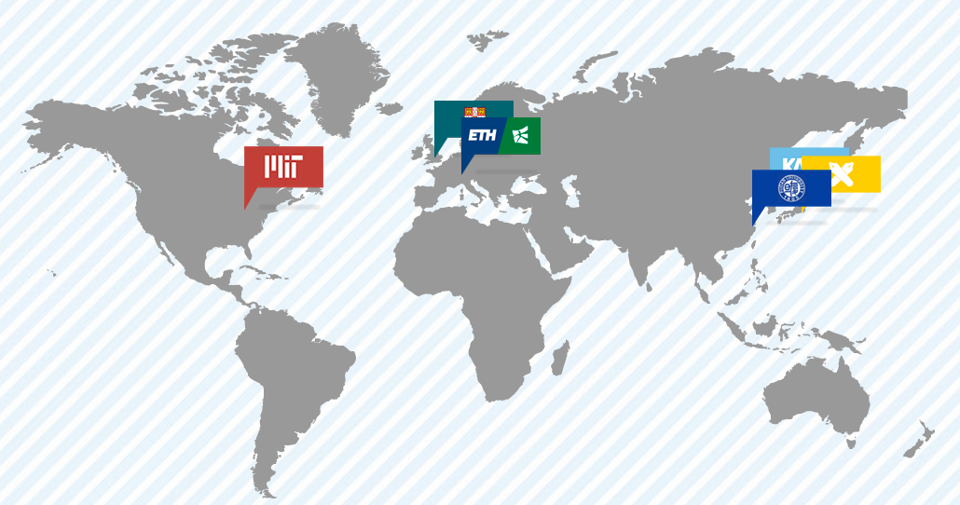
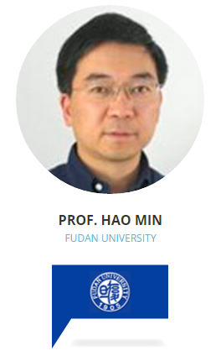
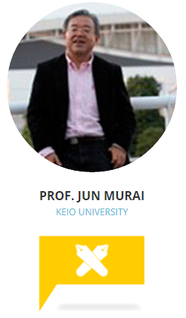
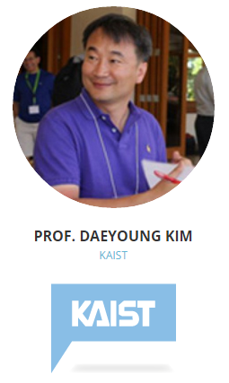



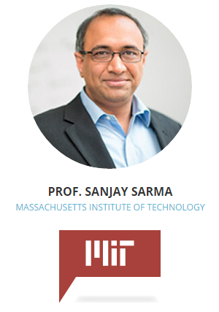
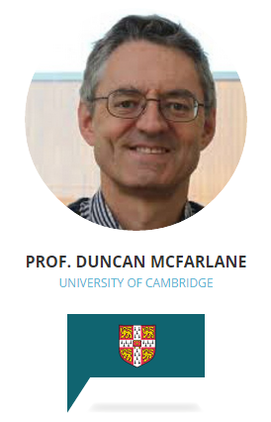
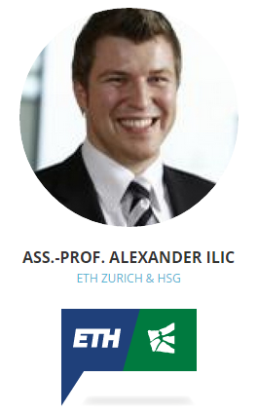



Auto-ID Labs – GS1 Research Partner
The Auto-ID Labs are an independent network of currently six academic research labs that research and develop new technologies for revolutionizing global commerce and providing previously un-realizable consumer benefits.
http://autoidlabs.org
Research Partner
Business Processes
and Applications
Software and Network
Hardware

Slide 8



























OOG(oneM2M, OIC, GS1) Three hot standards in South Korea

Slide 9
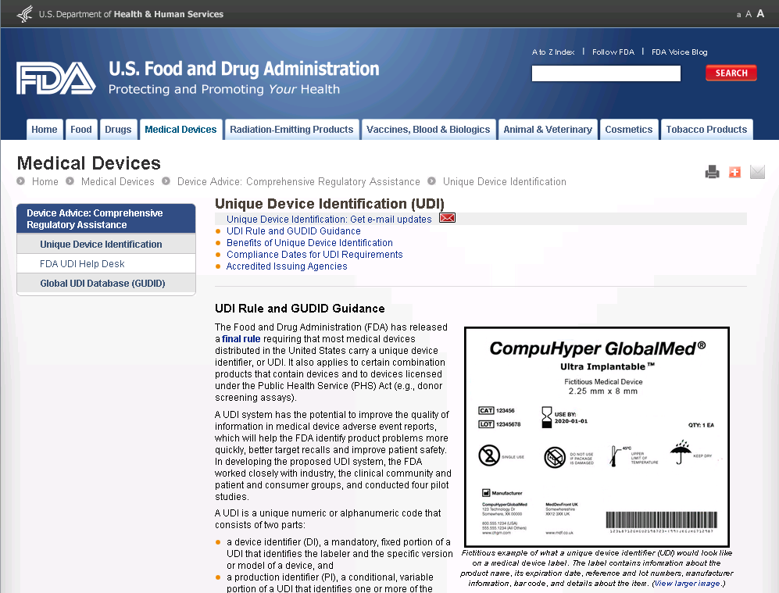

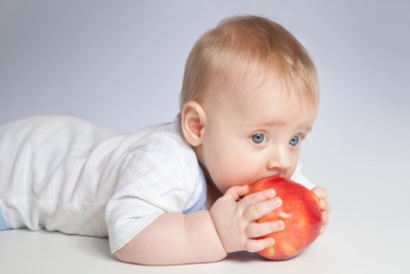
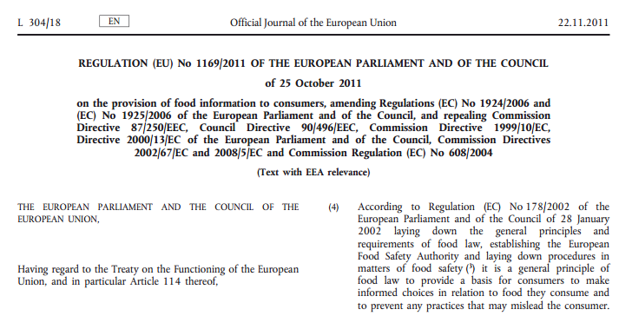
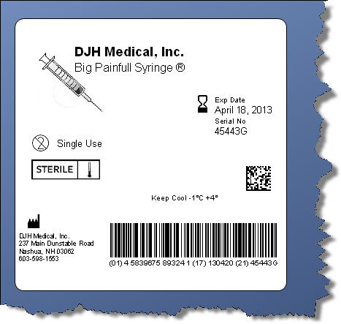
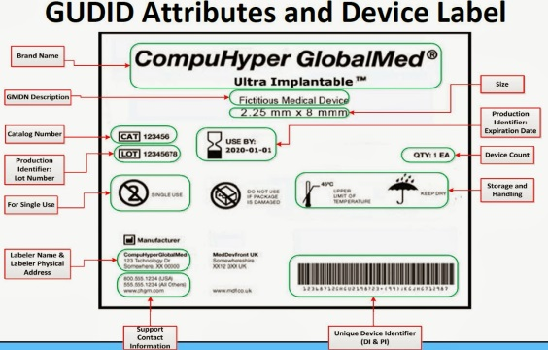
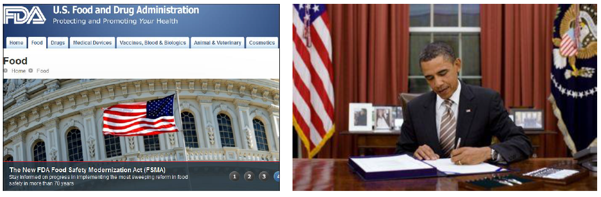
GS1 in Healthcare/Medical, Food Safety
Food Safety Modernization Act (FSMA) was signed on January 4, 2011and aims to ensure the U.S. food supply is safe by shifting the focus from responding to contamination to preventing it

Slide 10

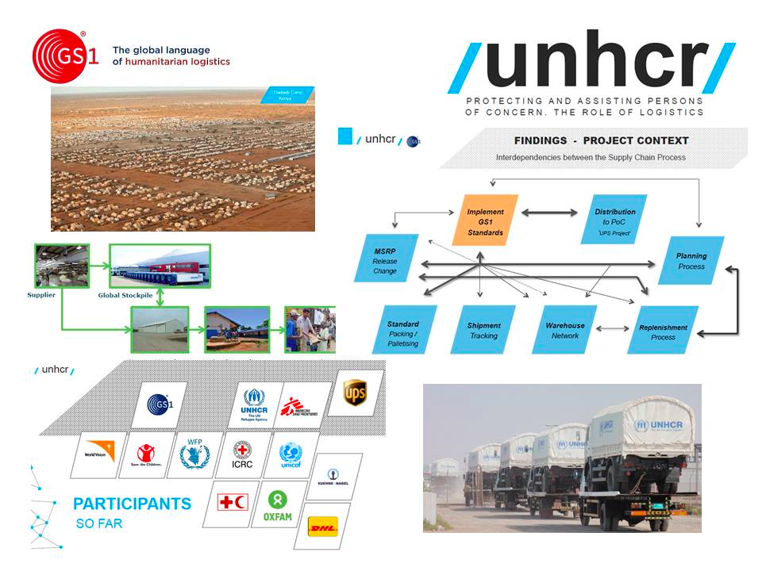
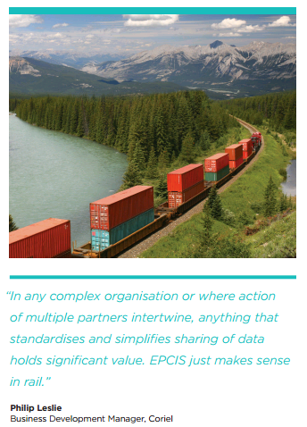
GS1 in Humanitarian Logistics

Slide 11
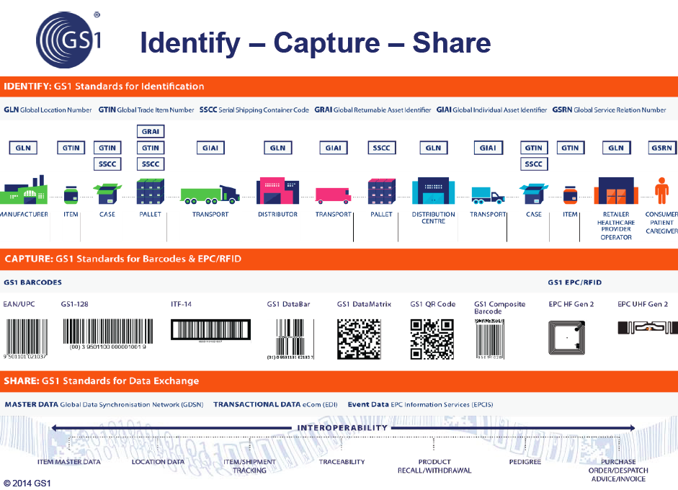
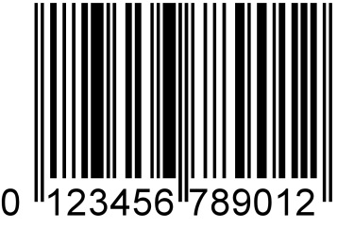
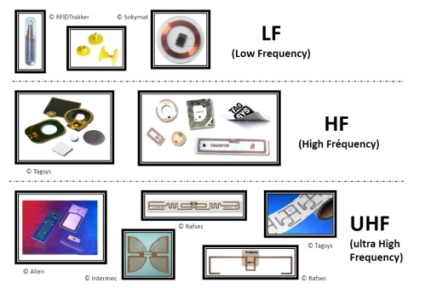
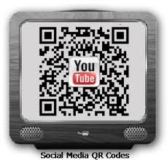
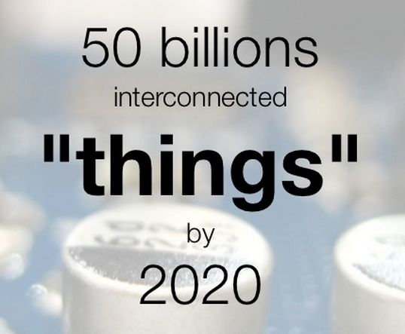





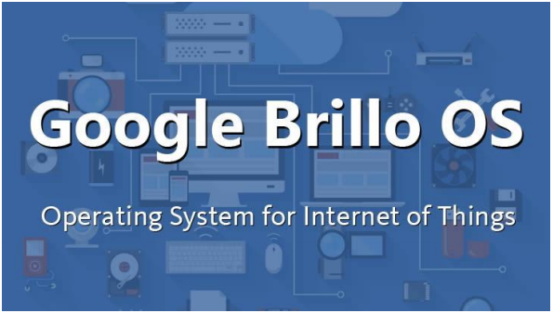

Oliot (Open Language for Internet of Things) implements GS1 standards and more

Slide 12


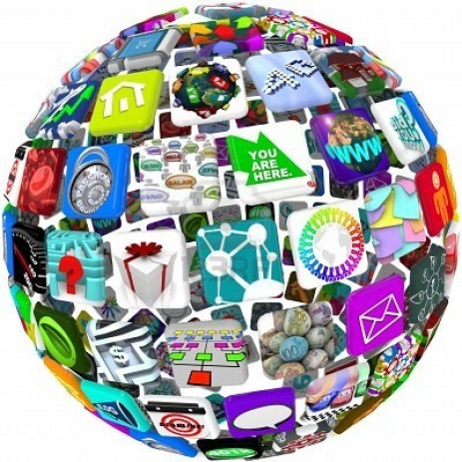


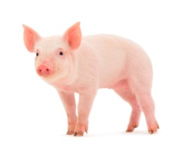
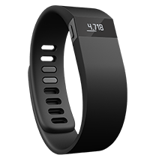

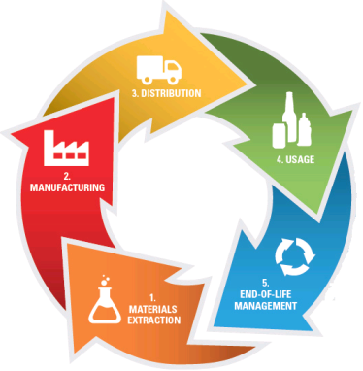
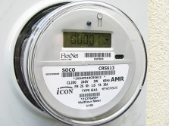
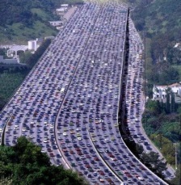
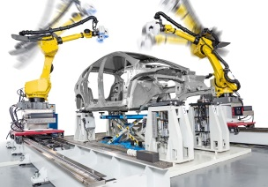



Oliot – Lifetime Data Management & Sharing
Any third party
Application/service

Slide 13

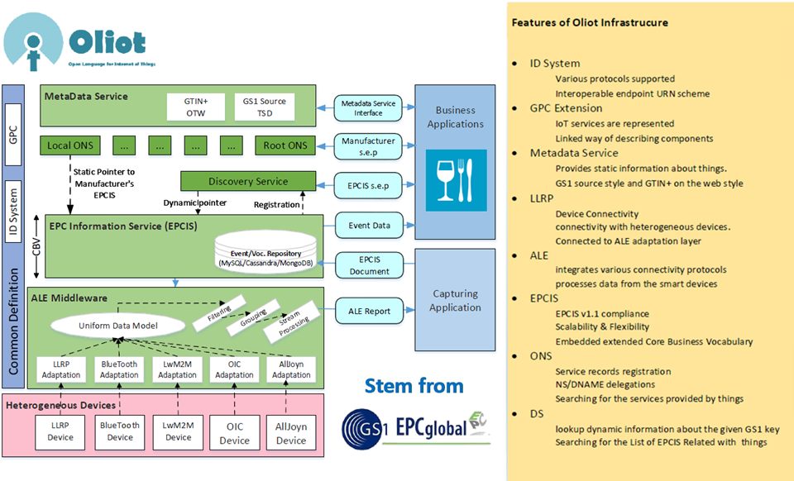


Open Language for the Internet of Things
http://oliot.org
Open Language for IoT (Oliot) is an
ID-based IoT Platform
Based on GS1 standard ID (e.g.URI-convertible GTIN)
Is to build a ID-based framework to identify, capture, control and share information about smart things

Slide 14

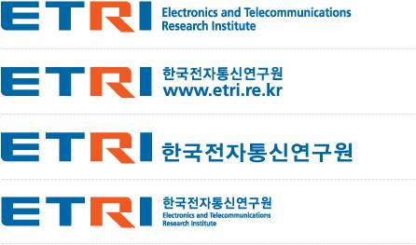







Oliot
in Smart Agriculture
Guardian Project
(2015.3 – 2018.2)

Slide 15
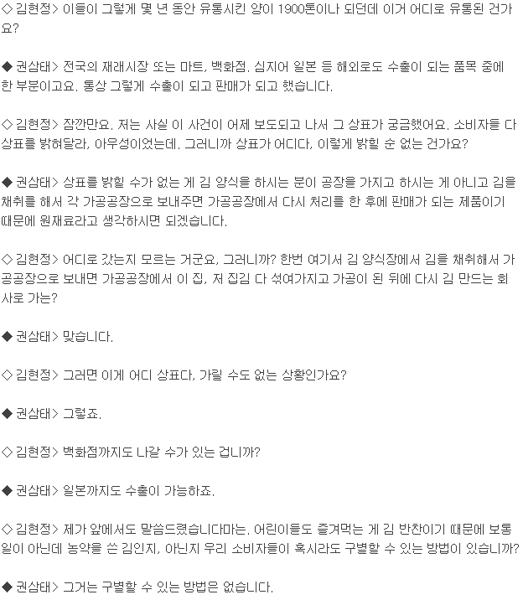
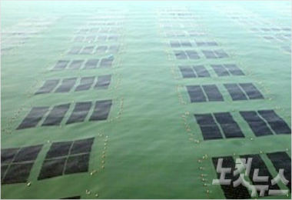
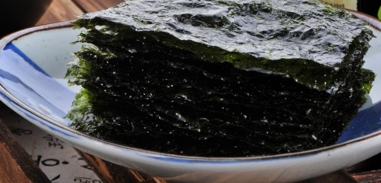
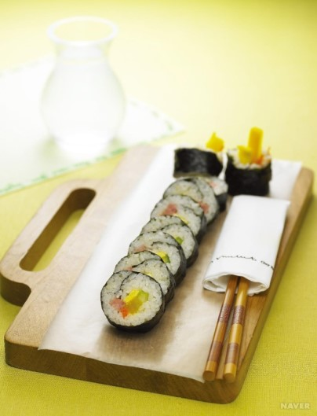
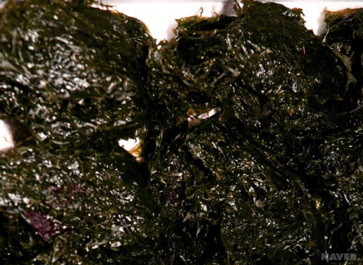
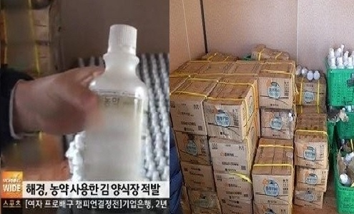
Incidents concerned with Food Safety
Used pesticide in Laver(seaweed) farms in Namhae, southern sea of Korea
1,900 tons, Nov. 2011 – Mar. 2014
sold in market, grocery, department store, even exported
No way of trace, track, and recall

Slide 16


Korean Guardian (Guard International Agriculture Network) Project
Balanced Production(균형생산), Transparent Distribution(투명유통), Safe Consumption(안전소비)

Slide 17

















Guardian Test Bed in 2015
계획생산
결과 제공
단계별 수급예측
GS1 표준 연동
모바일 영농일지
완주 로컬푸드
테스트배드
농산물 상품/이력
조회 서비스
농산물 이력정보
가시화
생산정보
EVENT
응용 서비스
판매정보 EVENT
판매정보 EVENT
상품 이력정보
서비스 환경
SNS/뉴스 데이터
정부 3.0 데이터
생산
API
저장
API
소비
API
SaaS Platform
GS1 Traceability/Recall
Agri-food Pedigree
SaaS
상품정보 위변조 방지
판매정보 EVENT
미들웨어
모듈
플랫폼
템플릿
모듈
SNS 기반 식품 위해요소 검출
분석
모듈
PaaS
가상화
모듈
빅데이터
모듈
Oloit EPCIS
이벤트 저장소
ONS
네임 서비스
GS1Source
상품정보저장소
IaaS
Oliot GS1 Common Service
Private 클라우드
잔류농약
검출EVENT
상품 등록정보
생산/유통 EVENT
휴대용 간이 농약 검출장치
GS1 연동형 바코드리더, 전자저울, 환경센서

Slide 18



Guardian Project – Testbed (2015)

Slide 19




Guardian Project – Testbed (2016)

Slide 20






Guardian Project – Testbed (2017)

Slide 21

Oliot
in Healthcare
(2016.7 – 2020.6)

Slide 22





Example. Curing Alzheimer/ADHD
Ybrain’s Brain Healthcare
MEASURE
+
MODIFY
= CONTROL

Slide 23





Lifetime Data Management of Y-Band
Manufacturer EPC
(Device) Information service (EPCIS)
Device log service
Device information (e.g., meta data, part/
component, test data)
Device Log analysis
Device Log collector
UDI
Test automation application (TAA)
Manufacturing Support Application
(MSA)
YBrain application
YBrain Mobile SDK
Production stage
After production
PCB test
device usage log
Final test
UDI assignment
system log

Slide 24

Smart City Busan
Oliot
in Smart City
With new EU-KR Wise-IoT Project
(2016.6 – 2018.5)

Slide 25

Centum City
Centum City now has become the home of more than 1,200 ICT
Firms and 15,000 high tech employees in 10 years.
Notes:
We name the place as Centum City. Cent in greek 100. We built the city to be a perfect city to live to work and to play. Many thai gov’t officials have visited Centum city to see IoT, smart city, creative economy case study.
Personnally, I was in charge of the development and I am very proud of myself to see what it is today.

Slide 26

Why Smart City?
Notes:
With having these experiences in the past, it was quite natural for Busan to move into the smart city building.

Slide 27


Smart City Test Site at Centum City
VISION
Busan, A Global Smart City Hub
Global Smart City Reference Model
Sustainability
IoT Based Knowledge City
GOAL
(By 2018)
1,500 IoT
Professionals
150 Creative
Enterprises
15 Global
hidden champions
15 global
common services
Focused
Area
Centum IoT Test-bed
IoT-based Smart City
Infrastructure
IoT Ecosystem
Open Platform based test-bed
- New Technology Development
& Demonstration
Demonstration Business for
Service Model
Successful model discovery
& spread
Integrated management of
City Infrastructure
System establishment
Standard ICT Infrastructure
considering Service expandability
Regional IoT Innovation through
Industry-Academy Collaboration
Well-developed infrastructure
for Small Business /Start-ups

