Slide 1
H2020 research and innovation framework programme
SMART TAGS DRIVEN SERVICE PLATFORM FOR ENABLING ECOSYSTEMS OF CONNECTED OBJECTS
Dr Srđan Krčo

Slide 2
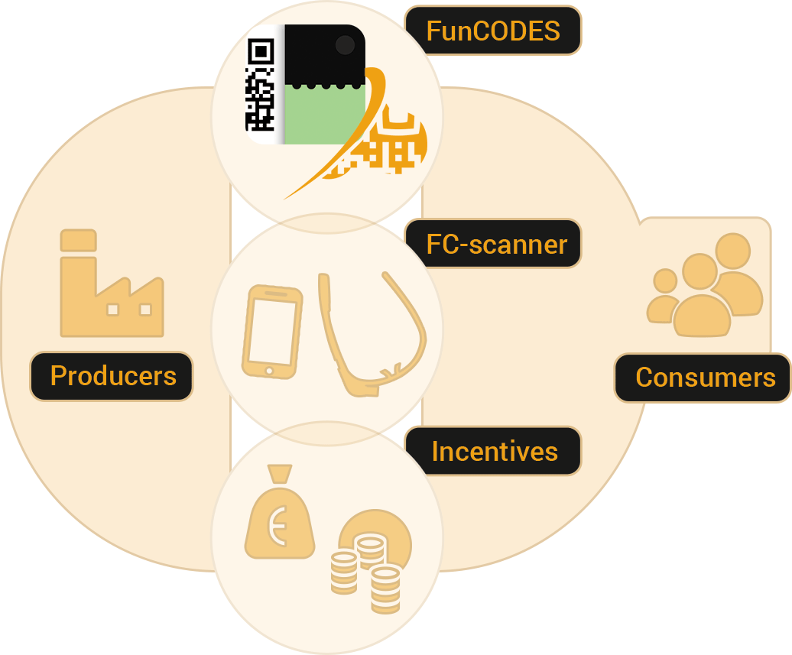
Concept overview
Services

Slide 3
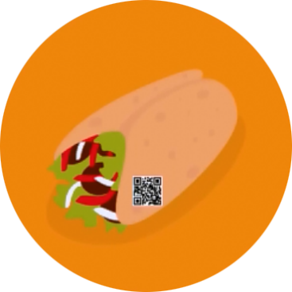
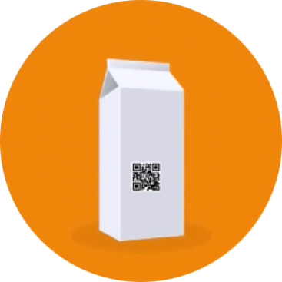
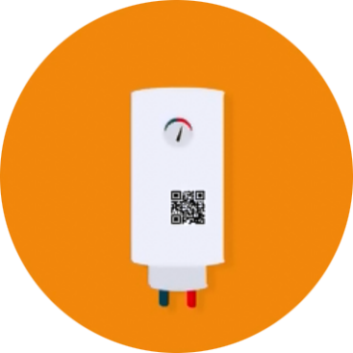
Overall objective
Connected mass market products
with unique identity that can report on their environment

Slide 4
Overall vision
Functional ink and printed NFC
IoT for mass-market domain
Optical tags
Crowd sourced readers
Cloud

Slide 5
Overall objective
Create tools and enabling technologies
to connect mass-market products with the digital world
across multiple application sectors and the value chain
integrated into a platform with open interfaces

Slide 7
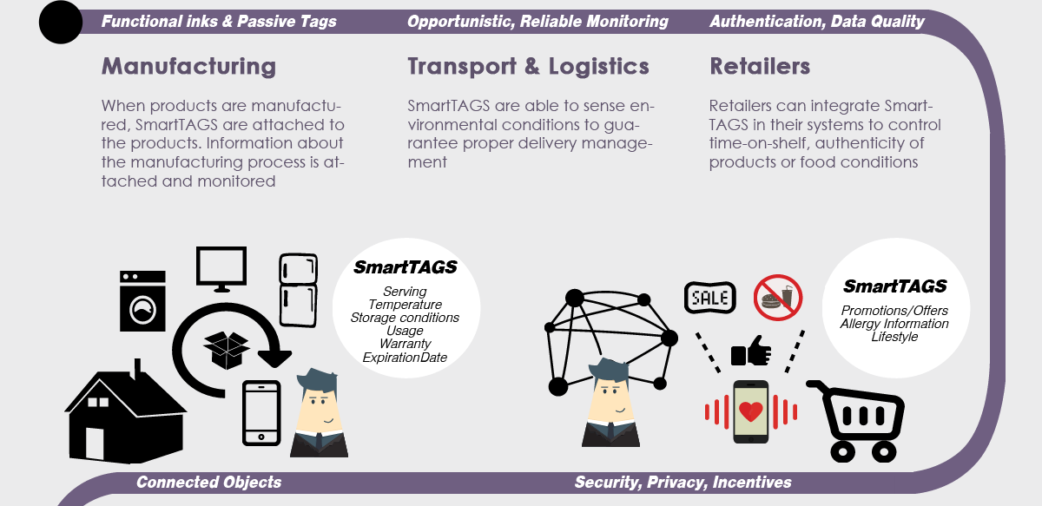

Slide 8
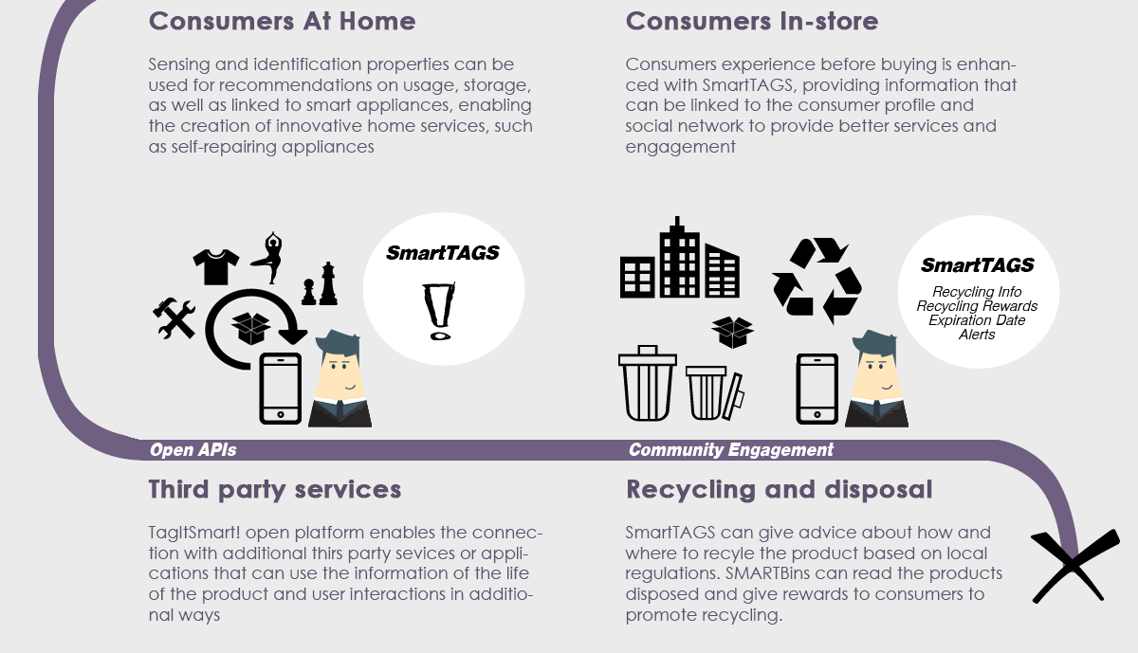

Slide 9
Why should you care?
Consumers
Able to get additional assurance about authenticity of the product, information about the way the item in hands was handled, transported etc. as well as to receive other services and incentives provided by manufacturers, retailers and third party service providers.
Manufacturers
Retailers
Developers
www.tagitsmart.eu

Slide 10
Why should you care?
Consumers
Manufacturers
Able to track individual items they manufactured throughout the product lifetime, thus offering insights into how the item is being handled, used and finally disposed of as well as enabling them to interact directly with the consumers.
Retailers
Developers
www.tagitsmart.eu

Slide 11
Why should you care?
Consumers
Manufacturers
Retailers
Retailers will be able to monitor individual items on the shelves, improve logistics and supply chain and offer new services to consumers.
Developers
www.tagitsmart.eu

Slide 12
Why should you care?
Consumers
Manufacturers
Retailers
Developers
Able to build applications and services on top of the open API and provide them to consumers whenever a tagged product is scanned.
www.tagitsmart.eu

Slide 13
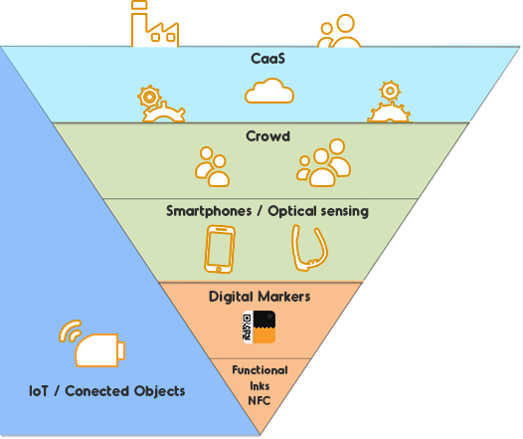
Research challenges
Composition as a Service: - Objects linking (WoT, SDKs)
- Service templates
- Complex information
Consumer: - Contextual Information
- QoS, QoI
- Security and Privacy
- Lower barriers
- Incentive
- Augmented Reality
Service Intelligence
Smarter Objects: - Contextual Information
- Object Identity
Scale/Heterogeneity
FunCODES
FC - Scanners
IoT / Connected Objects

Slide 14
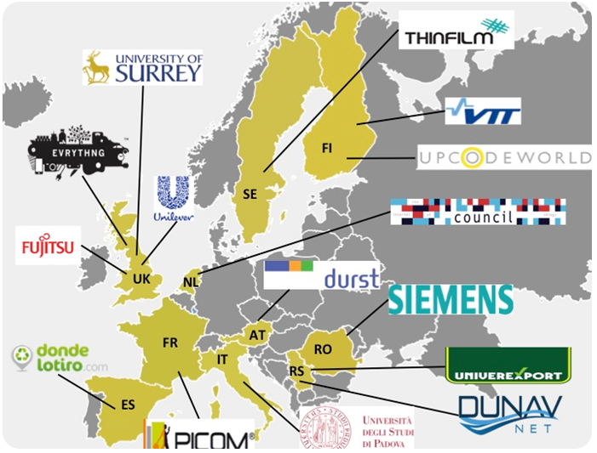
Consortium
Serbia: DunavNET, Univerexport
UK: Fujitsu Laboratories of Europe, Univ. of Surrey, Evrything ltd., Unilever
Finland: VTT, UPC Consulting ltd.
Italy: Univ. of Padova
Romania: Siemens srl.
Sweden: Thin film Electronic AB Austria: Durst Phototechnik Dig. Technology GmbH
France: Pôle des Industries du Commerce
Spain: Lmental Sostenibilitat i Futur, S. Coop.
Netherlands: Resonance Design
Web: www.tagitsmart.eu
Email: info@tagitsmart.eu

Slide 15
Last, but not least…
2 open calls
Open call #1: Q1 2017
Extending TagItSmart platform
Open call #2: Q1 2018
Piloting services utilizing TagItSmart! functionality
budget 1,200,000.00EUR

Slide 17
H2020 research and innovation framework programme
srdjan.krco@dunavnet.eu

