Slide 1
IoT for environment
How can the Internet of Food and Farm 2020 project contribute to sustainable development goals 13 & 15?
Edwin hecker, Managing Partner, Schuttelaar & Partners

Slide 2
Agenda
An introduction to Schuttelaar & Partners
Towards an IoT ecosystem: the IoF2020 project
How can IoF2020 contribute to SDG 13 & 15?
Discussion

Slide 3
Introduction Schuttelaar & Partners

Slide 4
Health & Sustainability
We are convinced that the world can and should become more healthy and sustainable. Our dedication aims to achieve this transition together with our clients.
Clean Technology
Life Sciences & Health
Good Food
Circular Economy
Sustainable Agriculture
Sustainable Fashion
Notes:
-Edwin introduces himself and the company (in general terms).
-S&P’s philosophy and division of the work in six different themes.
-S&P’s strength is based on four pillars: its people, location(s), years of experience and extended network of clients.
-S&P is a content driven, full-service strategic communications & public affairs agency.

Slide 5
Sustainable solutions
Public affairs and strategic communications for a healthy and sustainable world.
Strategic communications
Secondments
Crisis management
Stakeholder dialogue
Public Affairs
CSR Reporting
EU-funded projects
Online magazines
Strategic Advice
Notes:
-The slide gives a short overview of S&P’s products, spanning from strategic communications to the EU-funded projects.
-One of our most important (EU-funded) projects for the time being is a Horizon 2020 supported project – Internet of Food & Farm (IoF) 2020, which I will introduce to you in the coming slides. This matches our expertise in both EU-funded projects and sustainability.

Slide 6
Towards an IoT ECOSYSTEM: the iof2020 project

Slide 7
Iof2020 In brief
70+ PARTNERS ORGANISATIONS
16 COUNTRIES
4 YEARS
Start = January 2017
€35 MILLION BUDGET
(€30 million co-funded under EU H2020 programme)
Notes:
Some key figures about the project:
The Consortium comprises 71 partners from 16 countries.
The project duration is 4 years (started in January 2017 and will end in December 2020).
The total budget is €35 million (out of which €30 million co-funded by the EU under the Horizon 2020 Framework Programme for Research and Innovation)

Slide 8
Project Objectives
IoF2020 fosters a large-scale uptake of IoT in the European farming and food sector. In brief, it aims to:
Demonstrate the business case of IoT for a large number of application areas in farming and food sector;
Integrate and reuse available IoT technologies by exploiting open infrastructures and standards;
Ensure user acceptability of IoT solutions in farming and food sector by addressing user needs, including security, privacy and trust issues;
Ensure the sustainability of IoT solutions beyond the project by validating the related business models and setting up an IoT ecosystem for large scale uptake.
Notes:
This slide provides an overview of the project aim and objectives.

Slide 9
aMbItioN & VISION
BEYOND THE PROJECT
IoF2020 will pave the way for:
Data-driven and Sustainable Farming;
Autonomous Farm Operations;
Virtual Food Chains;
Personalized Nutrition for European citizens.
OPEN CALL
LARGE-SCALE EXPANSION
Notes:
IoF2020 will organize an open call around mid‐term for being able to involve new users in the use cases, develop additional and specifically more innovative applications, as well as to replicate the use cases through new sites or new connected devices, and complementary assessment of the acceptability of the use cases.
IoF2020 will pave the way for:
Data-driven Farming: IoF2020 will help farmers to change from ‘management by gut feeling’ towards ‘management by facts’, which is of crucial importance to survive its increasingly demanding business environment.
Autonomous Farm Operations: IoF2020 will improve the connectedness and intelligence of farm automation. As such it will enable farm equipment to become autonomous, self‐adaptive systems that can operate, decide and even learn without on‐site or remote intervention by humans.
Virtual Food Chains: IoF2020 will enable to virtualize food supply chain management which allows for advanced remote (re)planning, monitoring and control capabilities and for new business models.
Personalized Nutrition: personalized nutrition monitoring and advices by using smartphones, that make use of connected sensors, wearables like smart watches, equipment at home (e.g. refrigerators, weighing machines) and outdoor equipment (e.g. in canteens, restaurants, super markets, fitness clubs).

Slide 10
5 Trials, 19 use cases
ARABLE
FRUITS
DAIRY
VEGETABLES
MEAT
Notes:
The core of the project lies within 5 trials. These cover 5 sectors (arable, dairy, fruits, vegetables and meat).
To showcase each of the trials, the project is organized around 19 use cases.

Slide 11
Trials & use cases
A MULTI-ACTOR APPROACH
SMART SENSING & MONITORING
End-users
SMART ANALYSIS & PLANNING
Infrastructure providers
IoT integrators
Researchers
SMART CONTROL
Notes:
IoF2020 follows a multi-actor approach in which all the stakeholders in the food chain are involved : from farmers, cooperatives, equipment and logistic suppliers, food processing companies, to consumer organizations and it includes ICT developers.
IoF2020 envisions a transformation of the food and farming sector thanks to smart webs of connected and context-sensitive objects. These objects can be easily identified, sensed and controlled remotely. As such, they will drastically improve productivity and sustainability of the sector.

Slide 12
TRIAL & USES CASES METHODOLOGY Lean approach
Minimum Viable Product:
a product with just enough features to gather validated learning about the product and its continued development
TECNOLOGY
IMPROVEMENTS
Fine tuning
MVP3
Second Release
MVP1
Initial Deployment
DEMO
Large scale
MVP2
First Release
ECOSYSTEM
END USER FEEDBACK
Involvement & co-creation
&
BUSINESS
KPIs EVALUATION
Measurement & monitoring
Notes:
IoF2020’s innovative approach, the lean multi-actor approach allows to test the solutions with end-users in their operational environment and value chain stakeholders.
Feedback is translated into technical improvements that better meet end-users needs and better fit into the production environment and the value chain.
The figure shows that:
The process starts with initial deployment of technologies into their operational environment at the beginning of the use case;
It follows concurrent (i) measurement of use‐case performance and evaluation of KPIs coordinated by the business chair (ii) managing, facilitating and synthesizing feedback from end‐users and stakeholders along the value chain coordinated by the ecosystem chair;
Translating key issues demanded by end‐users and stakeholders into improvement, inserting or removing of technical features, coordinated by the technology chair.
By passing through this cycle, the technology is altered with a new set of features and a new minimum viable product (MVP) compared to the beginning of the process.

Slide 13
GENERIC APPROACH & STRUCTURE
IOF2020 ECOSYSTEM & COLLABORATION SPACE
WP3 IoT Integration
WP4 Business Support
WP2 Trials/Use cases: Knowledge & App development
Lean multi-actor approach
1. CO-DESIGN
2. IMPLEMENTATION
WP1 Project Coordination & Management
P3
P1
LARGE SCALE
P2
3. EVALUATION
WP5 Ecosystem Development
Notes:
Through these projects we have developed a success formula in approaching the challenge of ICT and Information Management in Agri-Food :
Trials and use cases form the core, in which we jointly develop as research and business organisations, knowledge and application through a lean multi-actor approach
This means that we quickly develop minimum viable products with involvement of all relevant stakeholders and upscale these through several cycles of development
In parallel we create synergy by
Technical integration: open architectures, standard that can be used as generic building blocks in the trials and use cases
Governance and business modelling: solve issues that arise from the trials and use cases regarding ownership, privacy, trust, etc. and support the businesses in developing sustainable business plans for the apps, services and organization structures that are being developed
Ecosystem Development – support the trials and use cases in embedding their solutions in global ecosystems and upgrading them to a large scale
Project coordination and management is trivial, but we have shown that Wageningen University and Research is very capable to fulfil this role in large public-private projects
This integrated approach will guarantee long-term, sustainable results from these projects.

Slide 14
TECHNICAL / ARCHITECTURAL APPROACH
USE CASE REQUIREMENTS
Use case level
Use case architecture
Use case IoT system developed
Use case IoT system implemented
Use case IoT system deployed
shared
services
& data
instance of
reuse
reuse
reuse
IoT reference architecture
IoT catalogue
IoT Lab
sustain
Project level
Reusable IoT components
Reference configurations & instances
Collaboration Space
Notes:
IoF2020 believes that it is important for a large scale take‐up to maximize synergies across multiple use case systems.
As a consequence, much attention is paid to ensuring the interoperability of multiple use case systems and the reuse of IoT components across them. The figure shows the architectural approach to achieve this during design, development, implementation and deployment.
To enable reuse of components, IoF2020 will provide a catalogue of reusable system components, which can be integrated in the IoT systems of multiple use cases of the project. It will include as much as possible existing components from previous and running projects and (open source) initiatives, including FIWARE, FIspace, etc.

Slide 15
COMMUNICATION & DISSEMINATION APPROACH
Continuous dialogue & communication with key stakeholders
Inform about the project, involvement of stakeholders
Sowing
Ecosystem (IoF2020)
Flowering
Ecosystem (IoF2020 + Open call, external stakeholders)
…pave the way towards a broader use of IoT in Agri-Food
Ecosystem (IoF2020 + Open call)
Harvesting
Notes:
Activities in WP5 split in three different phases: sowing, flowering and harvesting.
Aim to bridge the different communities of stakeholders (target groups and similar initiatives) around a same ecosystem.
Here talk about products: logo and visual identity, templates, UCs posters, banners, events calendar (sowing)
Website, H5Mag newsletter, social media, events participation and organisation (flowering)
Public affairs, site visits, video testimonials, final event, societal cafes (harvesting)

Slide 16
TOWARDS To The IoF2020 ecosystem
SCIENTIFIC COMMUNITY
FARMERS
INVESTORS
COOPERATIVES
CONSORTIUM PARTNERS
GENERAL PUBLIC AND MEDIA
POLICY-MAKERS AND REGULATORS
END-USERS
Farm equipment suppliers
Food processing companies
Retailers
Transporters
Consumers’ associations
BUSINESS SUPPORT ORGANISATIONS
Accelerators
Incubators
Chambers of commerce
Enterprises networks
IOT TECHNOLOGY PROVIDERS
NGOS & INTEREST ORGANISATIONS
AGRICULTURAL (INDEPENDENT) ADVISORY SERVICES
Notes:
Consortium participants and partner organisations
IoF2020 partners, other networks and initiatives with whom relations have already been established.
Stakeholders, directly using produced services and/or benefiting from the project outcomes.
Farmers
Cooperatives
End users
IoF2020 includes end-users for the entire supply chain, from farm to the plate.
IoT technology providers
Companies or other entities developing, producing and selling IoT technologies.
Agricultural (independent) advisory services
Services that make new knowledge available to farmers and assist the farmers to develop their farming and management skills.
Business support organisations
Entities supporting the establishment of a business entity.
Interest organisations / NGOs
Interest organisations are the entities representing interests of a particular sector.
NGOs are non-profit organizations, operating independently of government.
Investors
Entities committing capital for a financial return.
Scientific community
A diverse network of interacting scientists.
Policy makers and regulators
Individuals responsible for determining and applying policies and legislations.
General public & media
General public is the general community of people, regardless of their interests and/or occupations.
Media are the communication channels through which the IoF2020 key emssages can be disseminated.

Slide 17
Stay-tuned via
Website: www.iof2020.eu
Twitter: https://twitter.com/IoF2020
Newsletter subscription & contact: communications@iof2020.eu

Slide 18
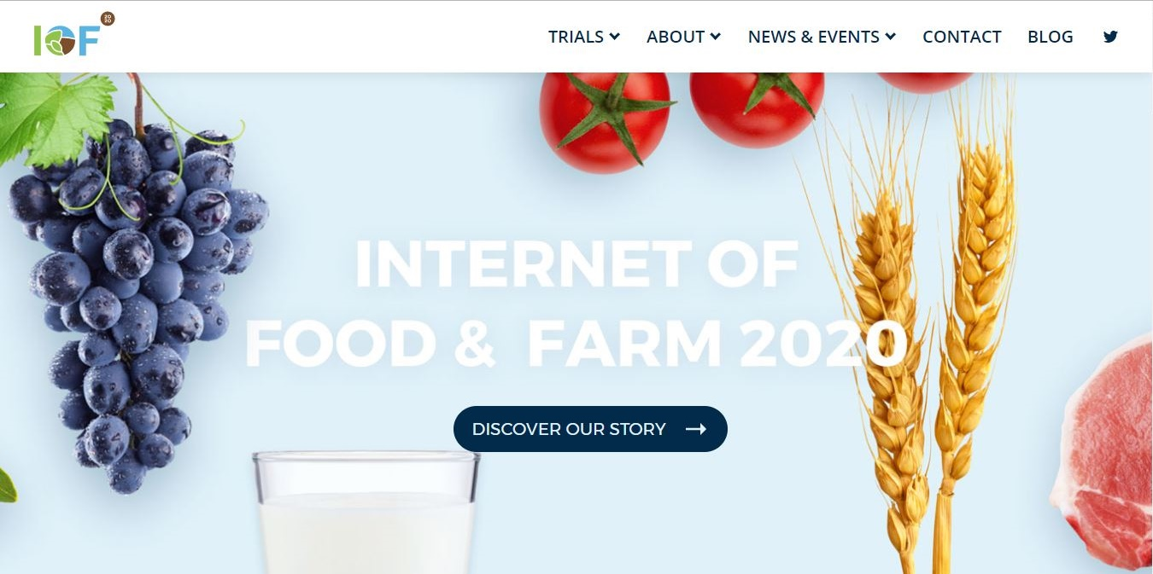
Few of our iof2020 products
The full-version of the website is now online: www.iof2020.eu
The IoF2020 booklet is available here at IoT Week
Subscribe to our newsletter

Slide 19
HOW can IoF2020 contribute to sdg 13 & 15?

Slide 20
SDG 13 & 15 and IOT
SDG 13 addresses the hazardous effects of the climate change by strengthening resilience and adaptive capacity, improving education and raising awareness.
SDG 15 promotes sustainable forest management, combats desertification, halts loss of biodiversity and reverses the land degradation.
IoT technologies can help protect forestry and biodiversity, improve agricultural produce (while reversing the land degradation) and induce establishment of the scalable low-carbon development models.
Notes:
-IoT technologies help farmers on two levels: 1. strategic level by helping them to become more sustainable, competitive and develop new business models and 2. operational level by helping them to take proper decisions related to the field management and optimization of resources (e.g. water, feed, fertilizers, energy etc.).
-An example: The case of tractor using GPS and satellite navigation system, helping its owner (e.g. farmer) to: 1. waste less (natural) resources (e.g. water, energy etc.), 2. use less fertilizers and 3. emit less pollution in the environment. Precision farming is about using technology to become more sustainable and competitive!

Slide 21
SDG 13 & 15
SDG 13 - Take urgent action to combat climate change and its impacts.
SDG 15 - Sustainably manage forests, combat desertification, halt and reverse land degradation, halt biodiversity loss.
Notes:
SDG 13:
strengthen resilience and adaptive capacity
improve education
and raise awareness.

Slide 22
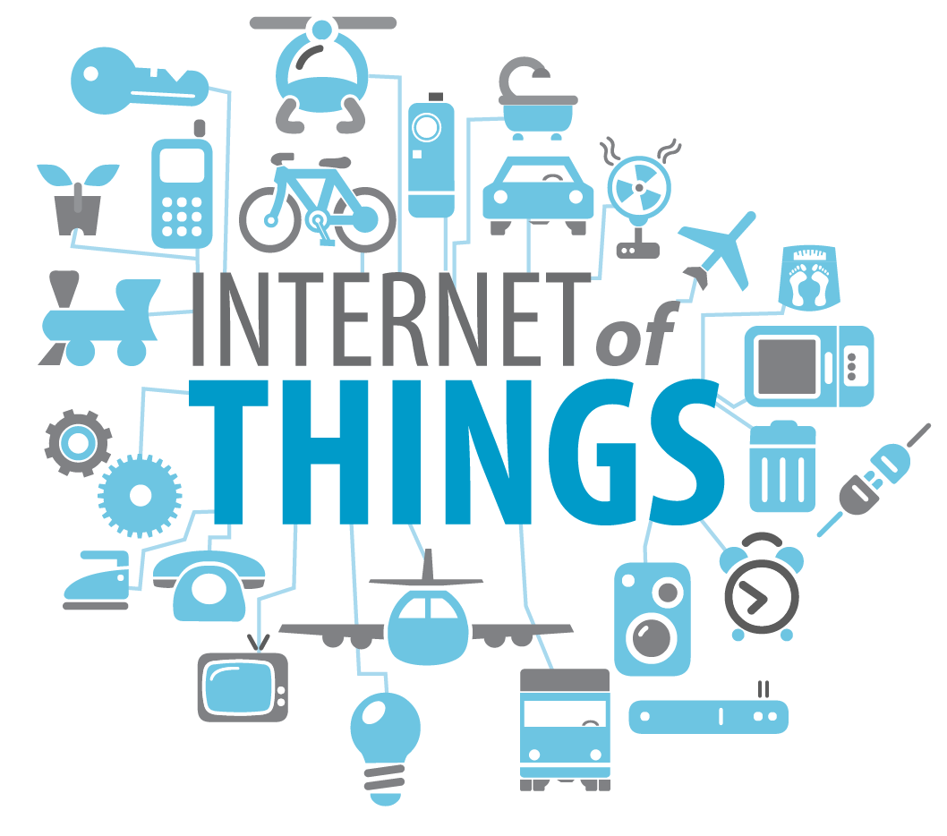
Internet of Things
‘The interconnection via the Internet of computing devices embedded in everyday objects, enabling them to send and receive data.’
Notes:
To understand how Internet of Things technology in agriculture can help to bring SDG 13&15 closer, we need to know first what IoT technology is.
Data collection via sensors -> data combination through interconnection of devices -> makes data analysis possible at a level we haven’t done before.
IoT has revolutionary potential in the food and farming industry, because
Insight in what happens at the field at much more precise level
Result of actions becomes visible.
Increased transparency throughout production chain
-> precision agriculture becomes a reality when IoT Technology is properly incorporated in our food and farming sector.

Slide 23
Data-driven farming and SDG 13 & 15
Data-driven farming deters effects of the climate change in the early stages of the agricultural production through the practical application of data analysis.
Data-driven farming does ‘more with less’!
It reduces the use of agrochemicals, antibiotics and energy inputs in the agricultural production, therefore helping preserve the natural resources.
Notes:
-Precision Agriculture (PA) is a whole - farm management approach using information technology, satellite positioning (GNSS) data, remote sensing and proximal data gathering. These technologies have the goal of optimizing returns on inputs whilst potentially reducing environmental impacts.
-On the one hand data-driven farming is doing ‘more with less’, while preserving biodiversity and mitigating the risks of land degradation.

Slide 24
Data-driven farming and SDG 13 & 15
Lower environmental impact
Increased productivity
Cost reduction
Transparent food value chain
Notes:
Lower environmental impact: less fertilizer needed, less water, less pesticides, less transportation
Increased productivity: higher yields, healthier animals
Cost reduction: less input=lower production cost
Transparant food value chain: adds value to the end product, educate consumers about source of their food, helps food & farming sector to tell their story.

Slide 25
Arable Farming
IoF2020 uses data acquired from the field (e.g. soil, crop and climate conditions), yield gap analysis tools, sensing networks, earth observation systems and crop growth models to ensure better yield and reduce the environmental impact.

Slide 26
Arable farming
Within field management zoning
Precision crop management
Soya protein management
Notes:
Three uses cases of interest in connection to SDG 13 & 15: Within-field management zooning use case shows how climate-related data can be used to predict yields.
Precision crop management use case reduces the environmental footprint in the wheat production through the efficient use of water resources.
Soya protein management use case improves the biodiversity and fertility of the soil by implementing the IoT technologies in the cultivation of the protein plants.
-For more details, please check the IoF2020 website.

Slide 27
Dairy Farming
IoF2020 addresses the environmental impact of the dairy sector through the real-time sensor data, machine-learning technologies and cloud-based monitoring systems.

Slide 28
Dairy farming
Grazing cow monitoring
Happy cow
Notes:
Two uses cases of interest in link with the SDGs:
Grazing cow monitoring use case focuses on the automated system for grazing of the cows, thereby enabling farmers to reduce the ammonia emissions from the pastures.
Happy cow use cases helps farmer to detect health issues at an early stage, reducing the need for medical treatment

Slide 29
fruits
IoF2020 ensures optimal fruits’ production through the use of sensor data, cloud-based monitoring systems and an early warning system for diseases’ and pest control.

Slide 30
Fruits
Automated olive chain
Big wine optimisation
Fresh table grapes chain
Intelligent fruit logistics
Notes:
Three uses cases of interest in connection to the SDG 13 & 15:
Automated olive chain use case reduces the use of energy, water and pesticides in the olive oil production through the application of automated devices.
Big wine optimisation use case optimizes the use of resources (e.g. water and land) in the wine production through the use of real-time sensors and data.
Fresh table grapes chain use case reduces the use of water and better protects crops through the use of weather and soil sensor data.
Intelligent fruit logistics use case increases transportation efficiency in the fruit production chain. Lower CO2 emissions from transport and reduced loss from spoilage during transport.

Slide 31
vegetables
IoF2020 manages indoor and outdoor vegetables’ production, including application of the climate-friendly measures. Use of data obtained from these processes helps preserving the soil fertility, eradicates weeds, and helps controlling pest and diseases.

Slide 32
Vegetables
Added value weeding data
City farming for leafy vegetables
Chain-integrated greenhouse production
Notes:
Three uses cases of interest in link with the SDGs:
Added value weeding data use-case collects location-specific camera data to provide insights the plants’ growth status and best harvesting moment, weed prevalence, nutrient shortages and drought stress. This data helps use water, nutrients and pesticides more efficiently.
City farming for leafy vegetables use case preserves the soil as a limited natural resource by applying the vertical farming methods.
Chain-integrated greenhouse production use case makes the indoor vegetables’ production more climate efficient by reusing the fresh water, applying energy efficiency measures and limiting the use of fertilizers.

Slide 33
Questions?

Slide 34
CONTACT INFORMATION
Mr Edwin Hecker, MSc
Managing Partner, Schuttelaar & Partners
Ehecker@schuttelaar.nl
+31 6 21 28 88 03

