Slide 1
IoT for Good Health and Well Being
Giuseppe Fico
ACTIVAGE Technical Manager
Universidad Politécnica de Madrid

Slide 2

Towards and iot enabled society
We got DATA
Give us SOLUTIONS!!

Slide 3
Internet of Things “Bill of Rights” Proposed by Pachube in 2011
People own the data they (or their “things”) create.
People own the data someone else creates about them.
People have the right to access data gathered from public space.
People have the right to access their data in full resolution in real-time.
People have the right to access their data in a standard format.
People have the right to delete or backup their data.
People have the right to use and share their data however they want.
People have the right to keep their data private.
Notes:
Proposed IoT Bill of Rights - http://postscapes.com/open-internet-of-things-assembly

Slide 4


The Burden of Chronic Diseases
For the first time in history, most people can expect to live into their 60s and beyond (In Europe 34% of population between 2000 and 2050).
The opportunities that arise from increasing longevity will depend on the health of older populations.
Most of health problems are linked to Chronic Diseases
(UN, 2015).
(WHO, 2015).

Slide 5

Effective and Efficient Models of Care
The prevalence of chronic conditions is rising.
Health care systems in developed countries are well suited to the treatment of acute diseases but are inadequate for dealing with Chronic Disease.
More emphasis on the prevention of disease.
New ways to reorient the provision of care.
A paradigm shift in the provision of healthcare
“Meeting the Challenge of Chronic Illness”
(Kane et al., 2005).

Slide 6
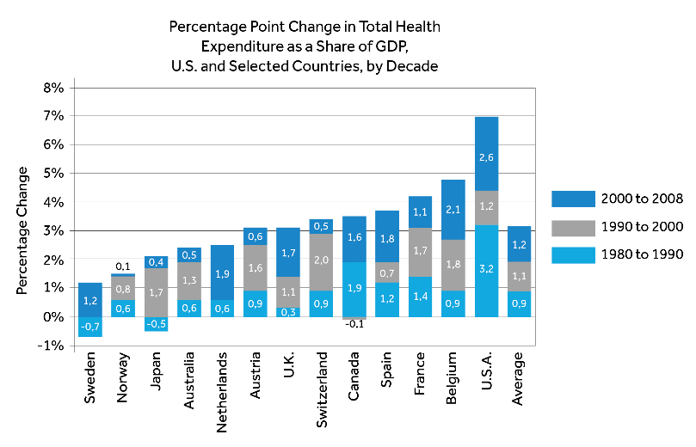
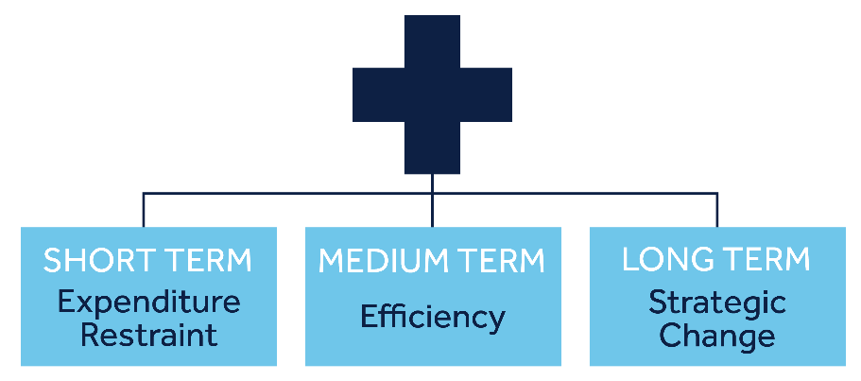
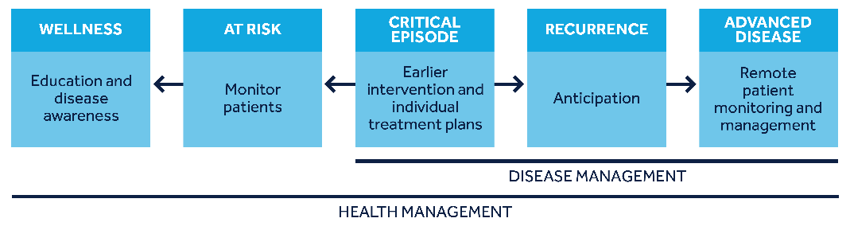
National Health System Scenarios
Innovations could provide better diagnosis, treatment and management across the continuum of care

Slide 7
horizon2020
Where is ACTIVAGE located?
SOCIETAL CHALLENGES
Health, Demographic Change and wellbeing
Food security, Sustainable Agriculture and Forestry, Marine, Maritime and Inland Water Research and the Bioeconomy
Secure, Clean and Efficient Energy
Smart, Green and Integrated Transport
Climate Action, Environment, Resource Efficiency and Raw Materials
Europe in a changing world – Inclusive, innovative and reflective societies
Secure societies – Protecting freedom and security of Europe and its citizens

Slide 8







Joining two domains
AHA
IoT
AHA
IOT
AIOTI

Slide 9
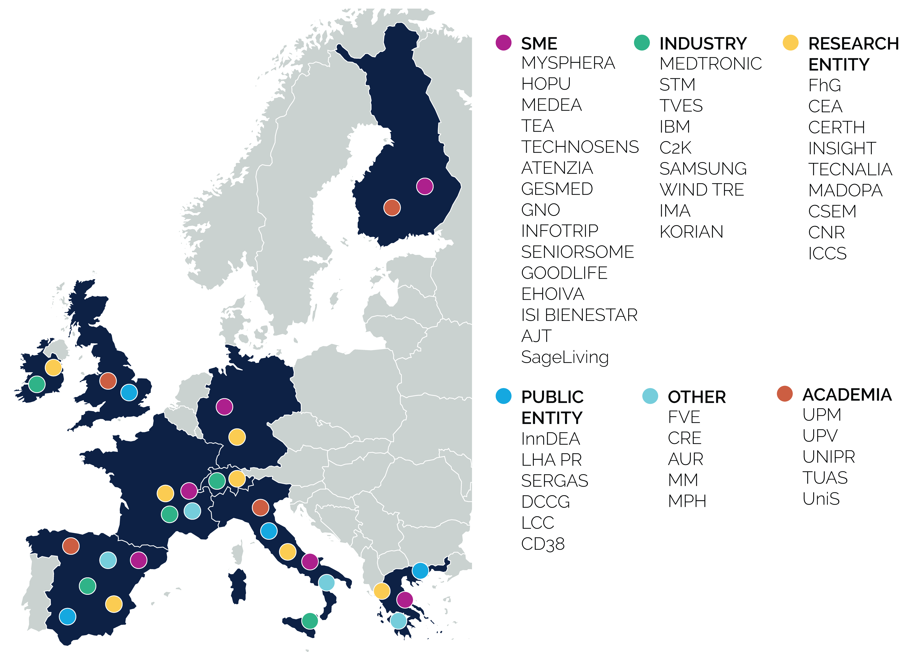
ACTIVAGE consortium
50 partners
SME’s, industry,research entity, public entity, academia
9 countries: Finland, UK, France, Germany, Italy, Greece, Czech Republic, Ireland and Spain
Coordinator: Medtronic Ibérica
25M€ total budget

Slide 10
Value Proposition
Quality of Life, Innovation and Growth enabler for AHA
AHA Digital Transformation
Activage
We are here
AHA
IoT Technologies
Notes:
There is a lack of sustainable models for health and care delivery in the EU. The absence of a coordinated approach to health and social care reforms combined with a lack of participation by patients and carers in the design, implementation and evaluation of the reforms in care systems as well as with "siloed" approaches to innovation have hindered the ability of realising a triple win for Europe: better quality of care for our populations, more sustainable and more efficient health and care delivery systems, and creation of economic growth and jobs in Europe.
Activage project ambition is to overcome barriers to scaling up innovation in AHA. These barriers result predominantly from dispersed initiatives and stakeholders, lacking critical mass and alignment on costs and benefits, fragmented markets across the EU and across the spectrum of services covering the care continuum.

Slide 11

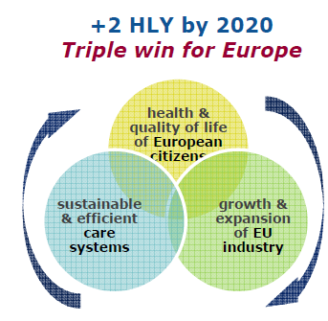
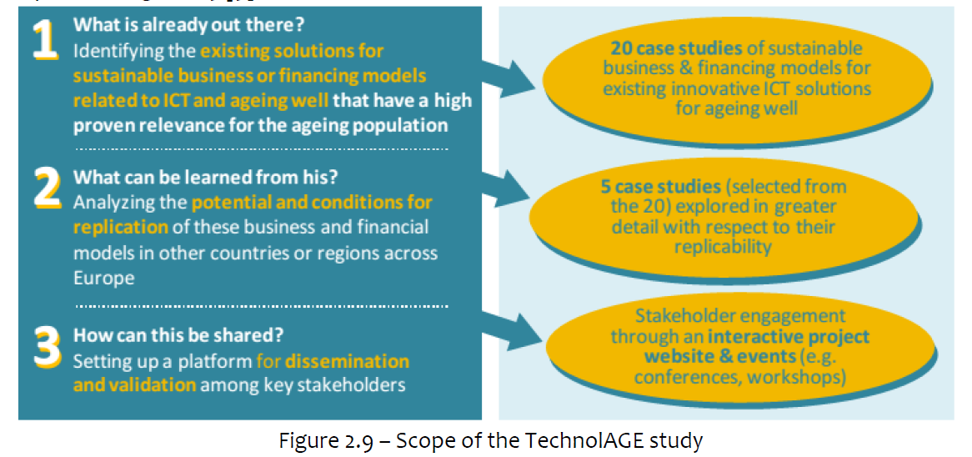





Background

Slide 12
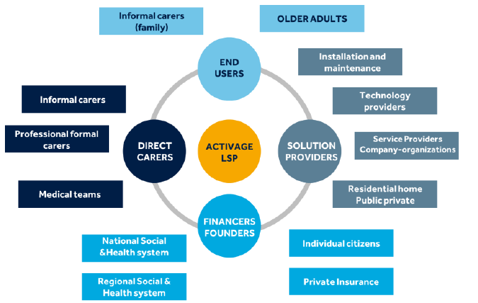
Vision
Sustain the value proposition
Ensure that senior citizens remain active and valued contributors to society
Contributing to sustainability of health and social care systems
Leverage demand side investments in innovative technology, solutions and services for AHA
Stimulate innovative health entrepreneurs
Stimulate creation of new jobs
Notes:
promotes digital health innovation in public services, improves inclusion and thereby contributes to sustainability of health and social care systems,

Slide 13
Evidence
2 More
Healthy Life Years
Quality of Life
Sustainable & Efficient Care System
Innovation &
Growth
HRQoL
Risk Factors
Service deployment indicators
Stake
Holder acceptance
Societal
perspective
Policy Makers
perspective
Physical
Activity
Economic Aspects
Scaling up & Integration
Industry
perspective

Slide 14


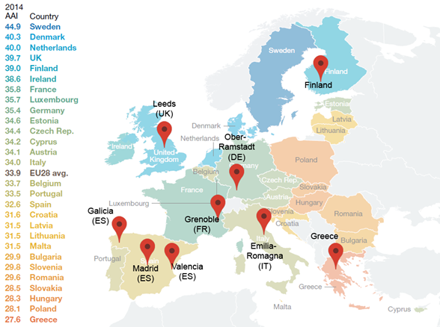

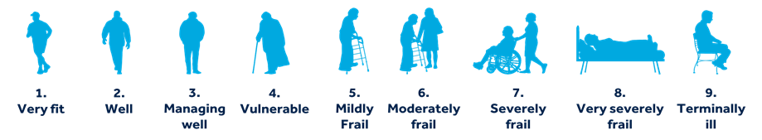
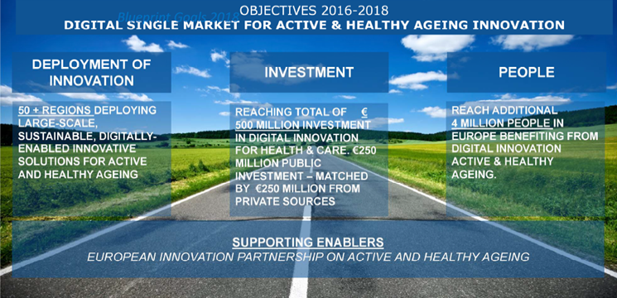
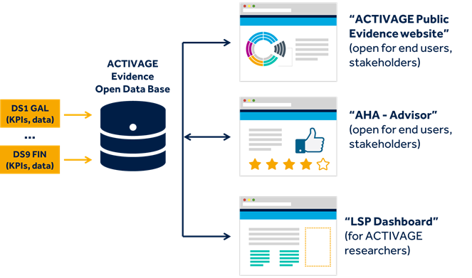
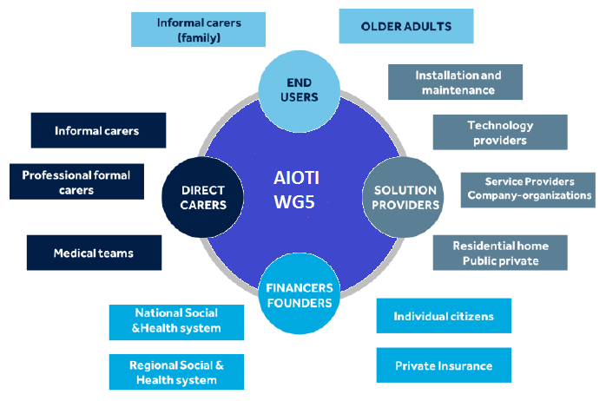
Allignement with AIOTI WG5
Ageing people
Relatives & Neighbours
Health Professionals
Care givers
Policy makers
Smart Living for Ageing Well
Strategic Issues
Technologies (Sensors, Actuators, Gateways, Services, Cloud, Security, Privacy)
Living Lab (co-creation, standardization, interoperability, personalization, modularity & continuous process)
Large Scale Pilots
1
ACCEPTANCE
2
USE CASE
PROTOTYPING
Influence
Business Model Innovation
Network Sustainability
User Empowerment
5
SUSTAINABILITY
ECOSYSTEM EXPANSION
Evaluation framework definition (KPIs)
Impact measurement ➔ Evidence
Data accessibility
Ecosystem enabling & uptake
Heterogeneity of the channels
Need to solve previous issues (2&3)
3
IMPACT
4
EVANGELIZATION

Slide 15









Activage Reference Use cases
Integrated care for
chronic conditions
Daily activity monitoring
at home
Monitoring outside
home
Emergency trigger
Exercise promotion
Cognitive stimulation
Prevention of social
isolation
Safety, comfort and
Security at home
Support for transportation and mobility

Slide 16
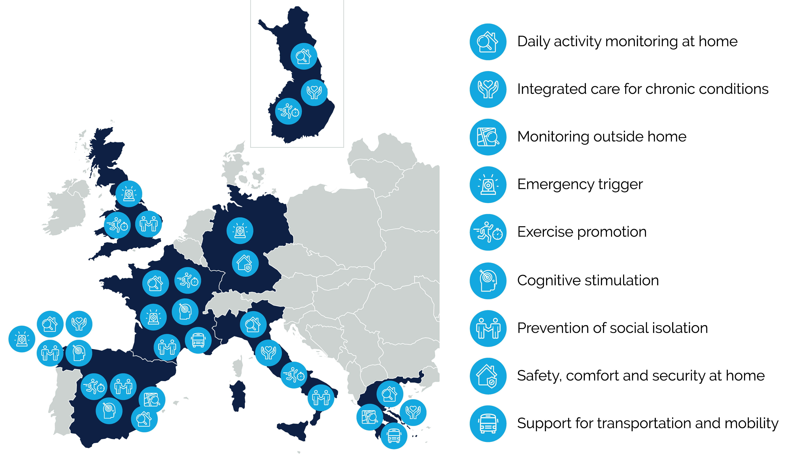
Use cases map distribution

Slide 17
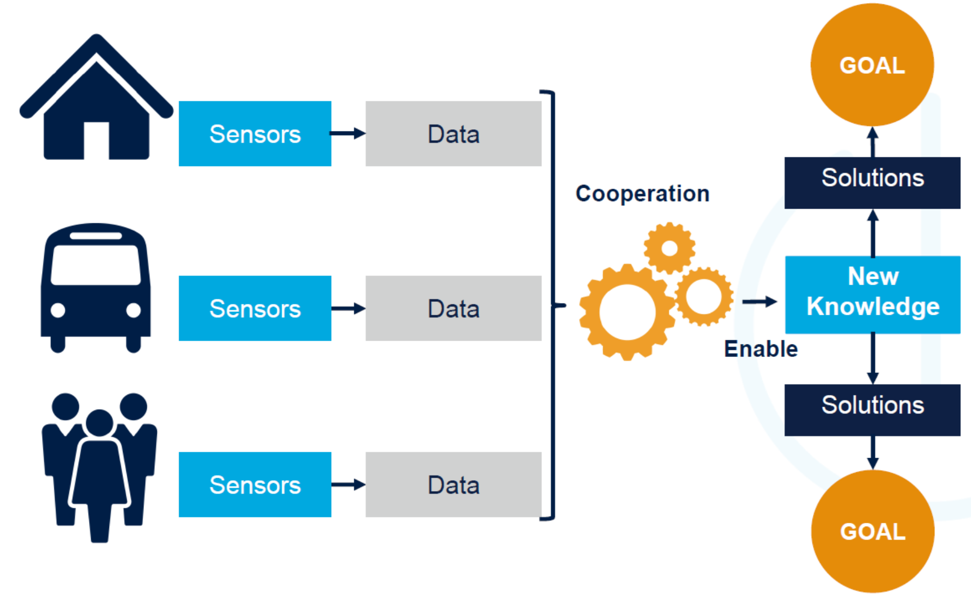
The IoT Scenario (…is this iot?)

Slide 18
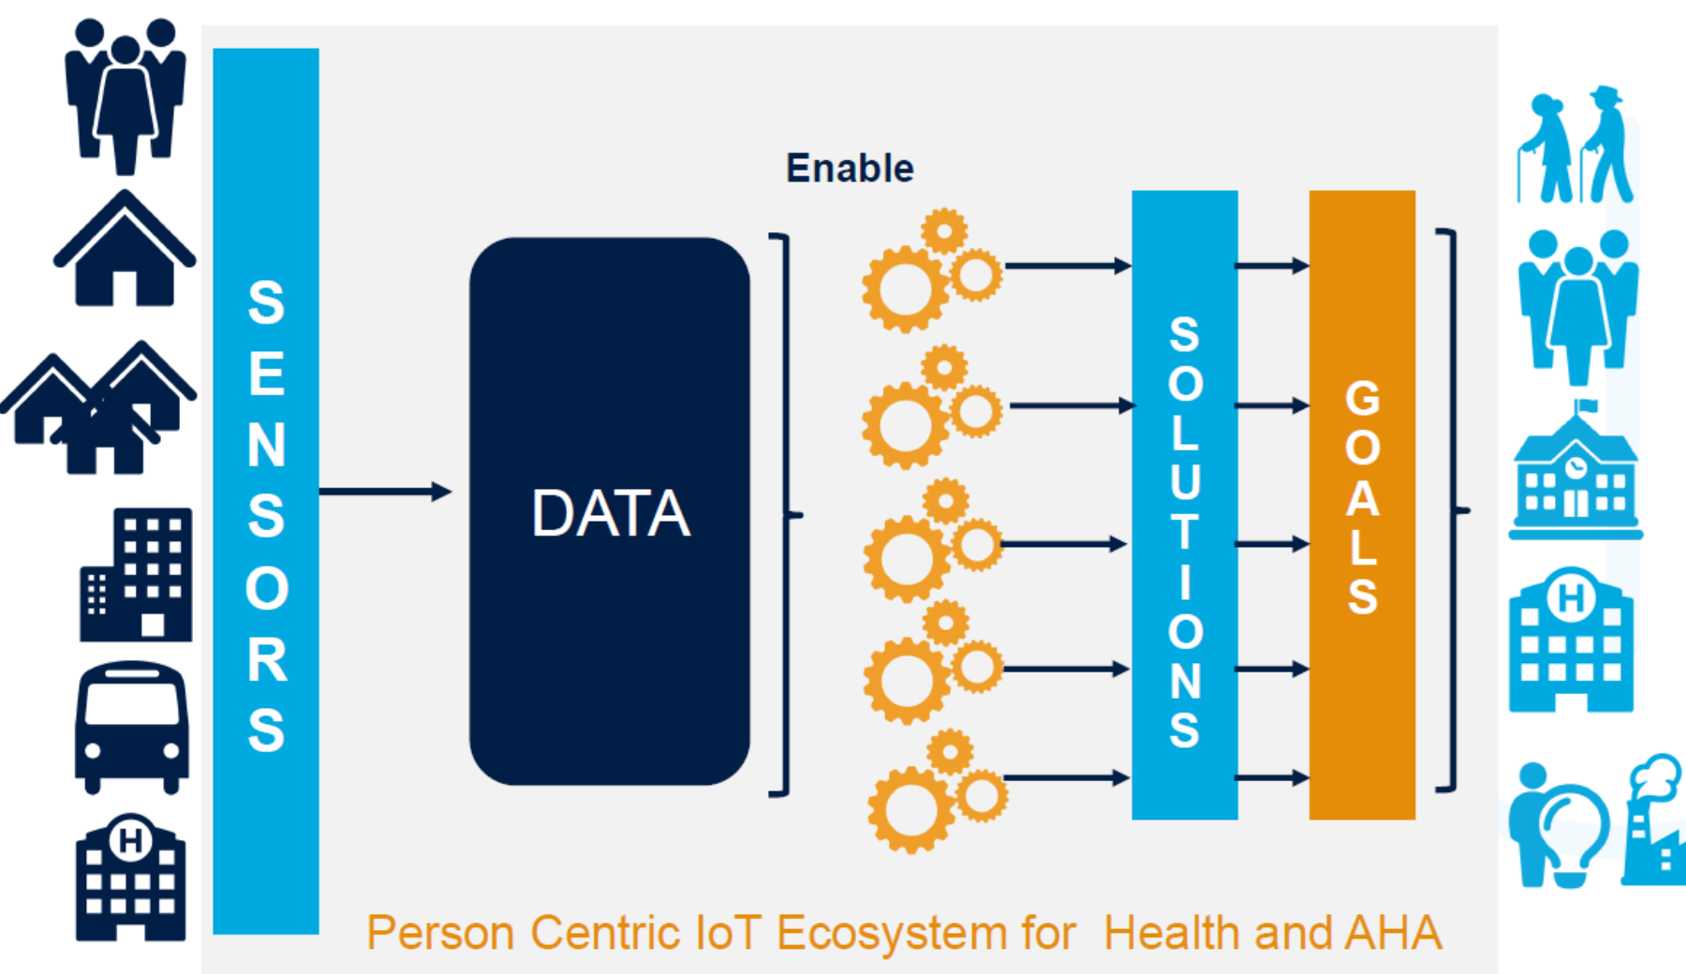
The IOT SCENARIO (This is IoT!)

Slide 19
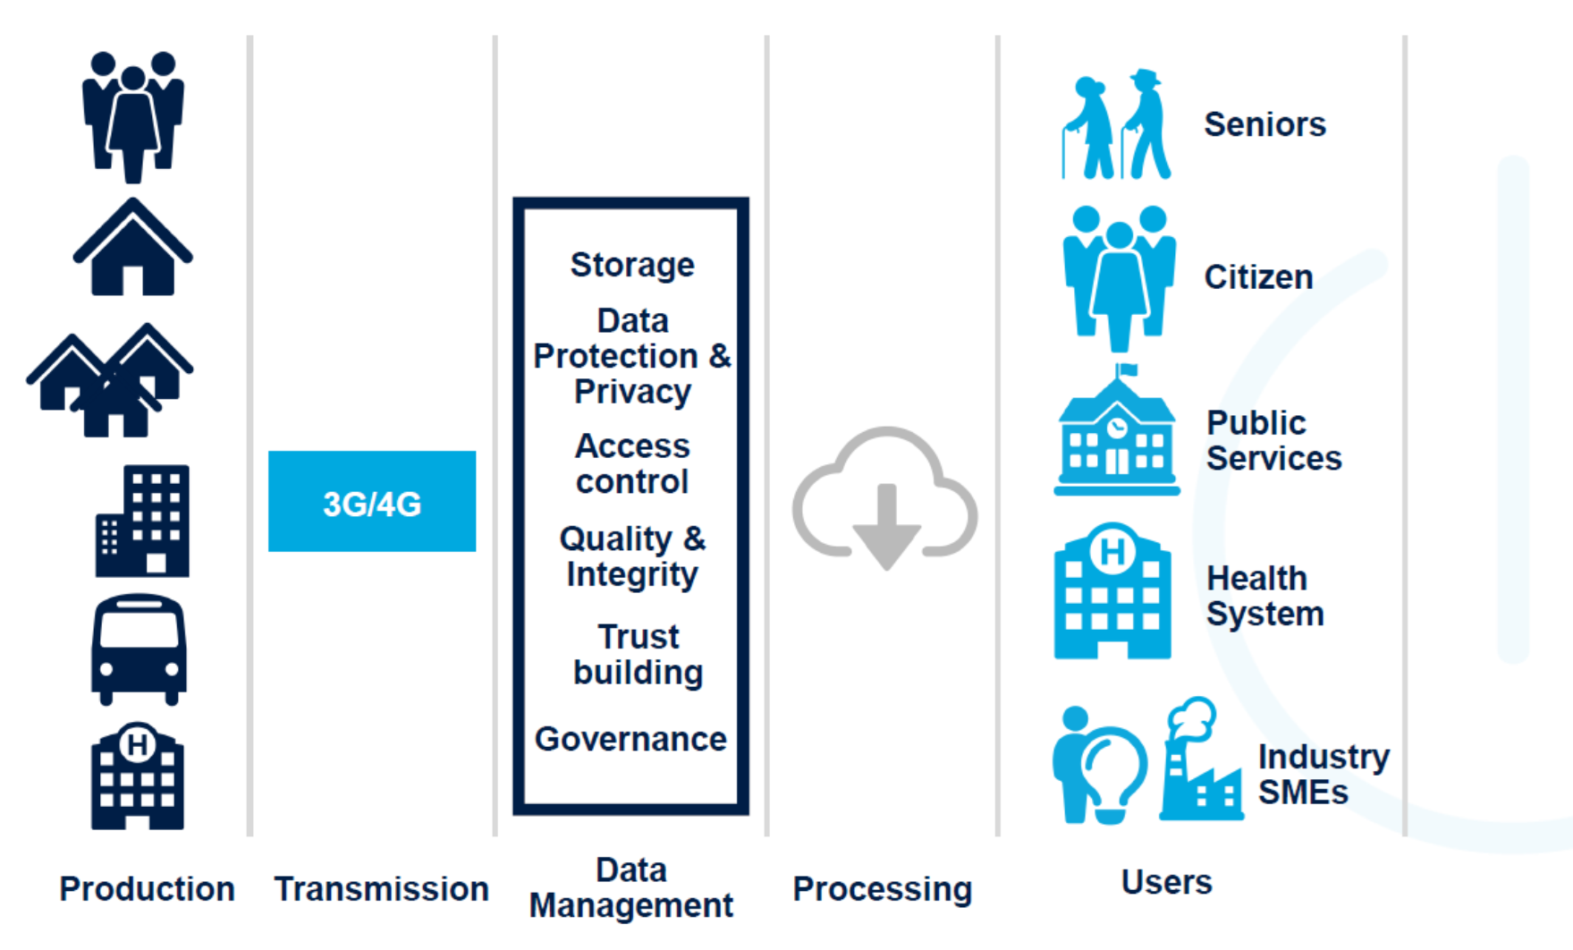
The IOT SCENARIO (This is IoT!)

Slide 20
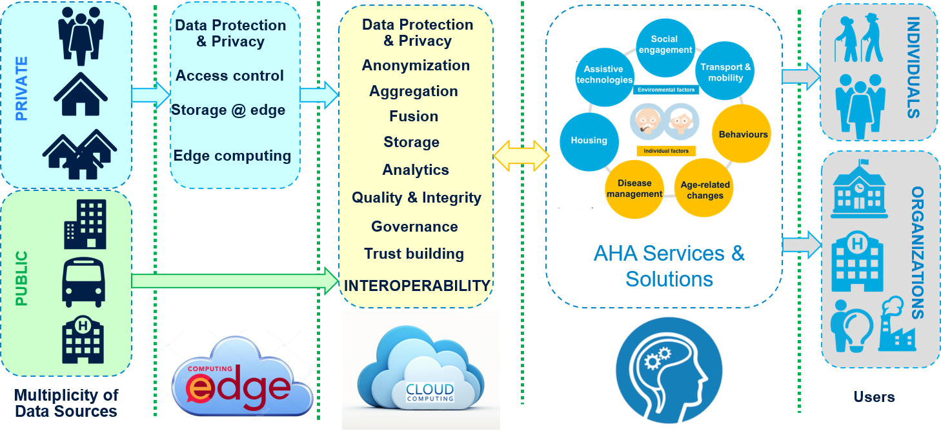
Towards an IoT-AHA DATA MODEL
Baseline
Sensor Domain
Gateway Domain
IoT Platform Domain
AHA Services Domain
Beneficiaries Domain

Slide 21


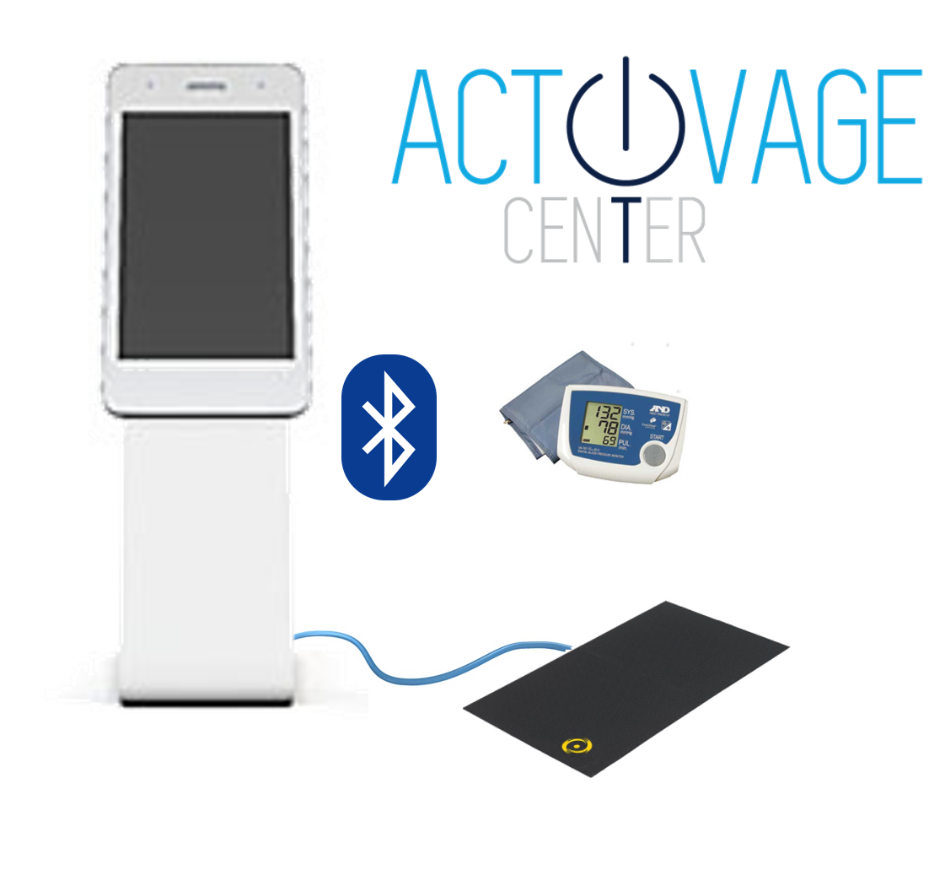

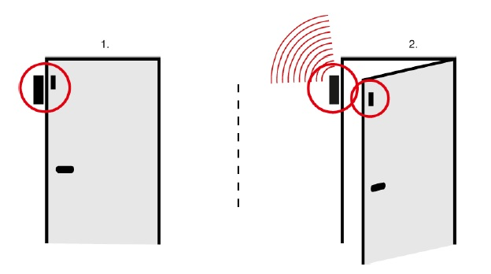









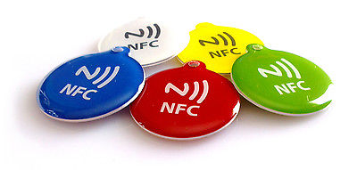




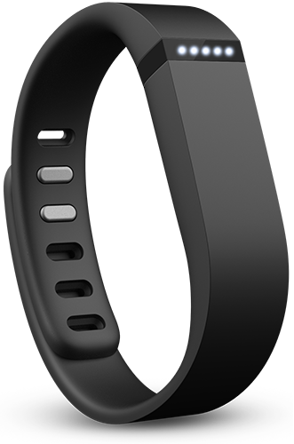
Technological solution
IoT System Architecture
IoT button
& light
Bluetooth
beacons
Bluetooth
beacons
AEMET
Blood Presure
Monitor
ACTIVAGE
Server
Equimetrix
Balance training
Door sensor
IoT button
& light
Bluetooth
beacons
EMT
Public transport
data
Smartphone
Android
NFC
tags
Wristband
FitBit alta HR2
Notes:
Escribir elementos

Slide 22
How to measure IoT value?
Why Big Research Questions?
In the different DS of ACTIVAGE project, IoT covers different practices and issues: telehealth, domomedecine, health-promotion, prevention, training, medical follow-up post-hospitalisation, autonomy, active ageing (etc.)

Slide 23
No IoT added-value should be taken for granted
For instance : Bower et al.: A comprehensive evaluation of the impact of telemonitoring in patients with long-term conditions and social care needs: protocol for the whole systems demonstrator cluster randomised trial. BMC Health Services Research 2011 11:184.
What is already known on this topic
For long term conditions, telehealth has been promoted to reduce healthcare costs while improving health related quality of life (HRQoL), by facilitating self monitoring with remote surveillance by healthcare professionals Evidence for the benefits of telehealth is ambivalent, with little empirical evidence on benefits on psychological outcomes Methodologically rigorous trials of telehealth in relation to health related quality of life and psychological outcomes are required
What this study adds
Compared with usual care, second generation telehealth had no effect on HRQoL, anxiety, or depressive symptoms for patients with chronic obstructive pulmonary disease, diabetes, or heart failure over 12 months The findings suggest that claims for potentially salutary or deleterious effects of telehealth are unfounded for most patients Telehealth should not be introduced with the aim of improving quality of life or psychological outcomes

Slide 24


8 PERFORMANCE INDICATORS BOXES
Box 1 Well being and QoL
Box 2 Clinical benefits
Box 3 Organization of care
Box 4 Economics
Box 5 Acceptability
Box 6 Sustainability
Box 7 ELSI and cultural issues
Box 8 Technical reliability in real settings

Slide 25
Towards and iot enabled society
We got DATA
Give us SOLUTIONS!!

